Slide 1
Welcome to Year 1
High Expectations for All
Soar on wings like an eagle (Isaiah 40:31)

Slide 2
Year 1 staff
Miss Aimee Gee – Monday and Tuesday/Wednesday
Mrs Catherine Scott – Wednesday to Friday
Mrs Jackie Cox Monday to Thursday – Support Staff
Miss Ruby Brett – Monday to Friday – Support Staff
Mrs Precy Pereira - Friday – Support Staff
Wednesdays we have a handover together out of class
Everyone in our school community has the right to
learn, be happy and to feel safe.

Slide 3
Communication Reminders
All urgent messages should be communicated to the School Office via telephone or in person on the day
Feel free to pass a note or letter to the member of staff outside on the playground in the morning
All non-urgent messages that you wish to communicate via email should be directed to the School Office on admin@digswell.herts.sch.uk – in the subject heading you can state who you wish the email to be forwarded to
To make an appointment with the class teacher, please collect a form from the School Office

Slide 4
Punctuality
Please ensure you arrive promptly, the registers are open between 8:40am and 8:50am
From 8:50am to 9:00am a late mark would be applied and you will need to enter school via the School Office to be marked in
Being late disrupts your child’s learning and attendance record

Slide 5
Attendance
Please ensure your child attends school at all times unless for illness or injury
Holidays during school time will not be authorised
Attendance is regularly monitored and you will be contacted by the school if your child’s attendance is low
If you would like to discuss your child’s attendance with school to see how together we can support your child, then please contact the School Office and ask for an appointment with either Mr Worton-Geer (Headteacher) or Mrs de la Croix (Assistant Headteacher and SENCO)

Slide 6
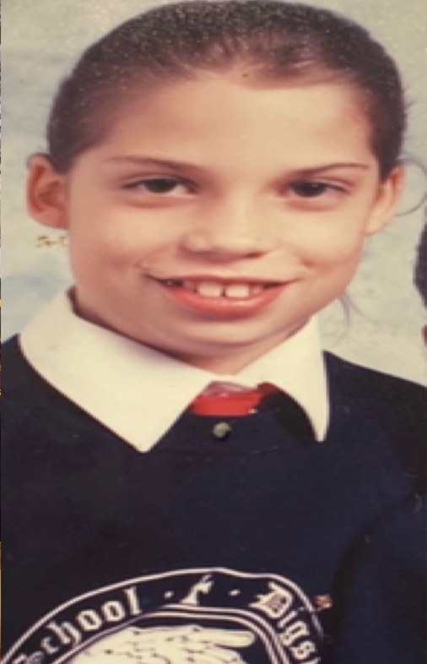
Uniform
Please ensure your child comes to school everyday in the correct uniform - plain black shoes or plain black trainers
Please ensure your child is dressed for the appropriate weather e.g. sun hats/raincoats
Label every piece of clothing
Water bottles to be brought in everyday
Book bags to be brought in everyday with their Monster Phonics book inside
Hair accessories must be plain black, navy, blue or blend in with the child’s natural hair colour – these should also be small and discreet

Slide 7
P.E.
PE days are Tuesdays and Thursdays
Please ensure your child comes to school in full P.E. kit
Please name ALL items of clothing
No earrings on P.E. days

Slide 8
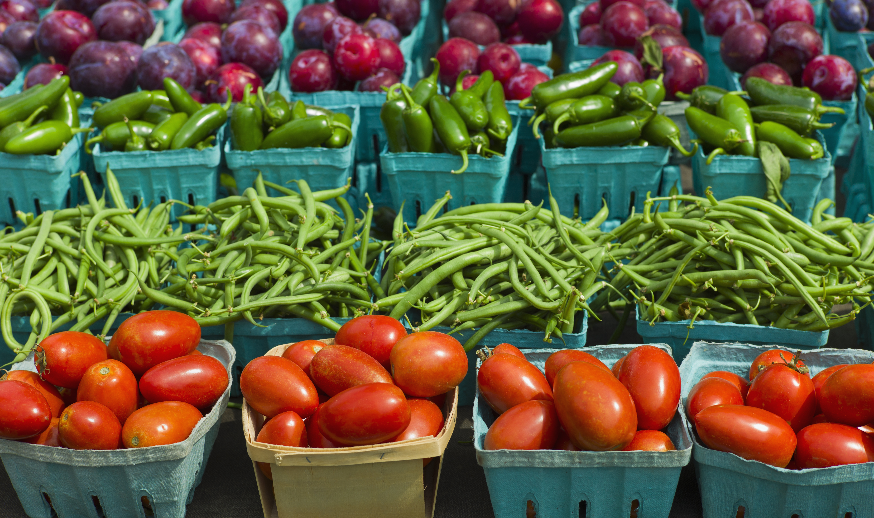
Healthy Snacks
Children do have access to school fruit and milk - if paid for - each morning, however if you would like to pack your child a healthy snack, you can, please make sure it is healthy (fruit, dry fruit, bread sticks and no nuts or may contain nuts products)

Slide 9
Behaviour
Everyone in our school community has the right to learn, be happy and feel safe.
7 steps of behaviour from our policy which is on the school website:
Raise the child's awareness
Reminder
Further reminder
Reflection time in class
Reflection time in phase leader class
Reflection time with Assistant headteacher
Reflection time with Headteacher
We WILL NOT take away parts of break times and lunch times unless it gets to stage 6.

Slide 10
Reading
Please continue to use BoomReader to log your home and school books
Build a time into your daily routine to ensure that reading occurs regularly
Help your child to sound out and blend together the sounds of words they do not know that can be sounded out – c-a-t = cat, sh-o-p =shop. Once children can read a word, they do not need to sound it out
For words that cannot be sounded out like, ‘said’ discuss the tricky bit – the ‘a’ and the ‘i’ make an ‘e’ sound and then sound out and blend the rest of the sounds to read the word s-e-d
Ask your child questions about what they have read to check their understanding

Slide 11
Reading
If your child is struggling reading the words, look at the illustrations and discuss what is happening before you read the page
If a child is struggling to read a word and using their phonic knowledge isn’t working, you could read to the end of the sentence and then go back to the word, look at the initial sound and see if your child can now work it out, or, look at the initial sound of a word and then look at the illustrations for a clue as to what the word could be
Aim for at least 3 read a week of the Monster Phonics book and supplement with other books

Slide 12
Year 1 approach
Short, whole class teaching sessions
Tutor groups during and Explore More time
Learning Challenges for children to show their learning in their own way
Engagement is intrinsically linked to attainment
We have created a Year 1 that is built around the pedagogy of the EYFS - a child-led approach, valuing children as individuals - to ensure a much smoother and quicker transition, while accessing the National Curriculum, but continuing to grow, encourage and reward life-long learning skills needed

Slide 13
PARENT OVERVIEW

Slide 14
NumBots
Introduction video
Numbots is an online maths learning platform that helps children learn how to add and subtract, improving their fluency and recall in basic mental maths and equipping them with basic maths confidence
Basic number skills are essential building blocks for higher-level maths concepts. NumBots covers number recognition, number bonds and addition and subtraction of double digit numbers; gradually helping your child build a solid conceptual understanding of number sense
We recommend a little and often approach, aim for 3 minutes a day, 4 days a week

Slide 15
NumBots

Slide 16
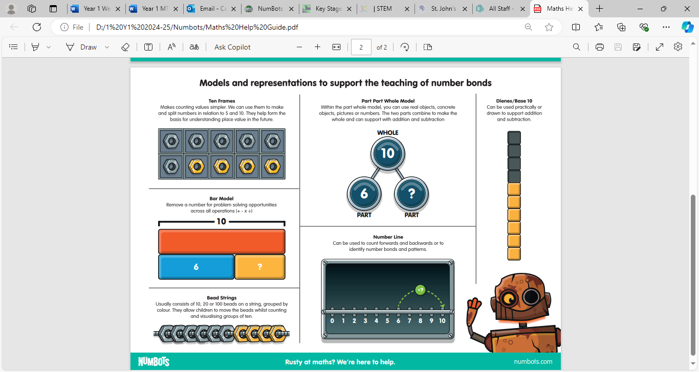
Numbots

Slide 17
Year 1 Phonics
Children will be taught spelling daily through Monster Phonics

Slide 18
Phonics Screening Check PSC
DO NOT STRESS!
Year 1 children take the Phonics Screening Check in the first week of June every year. Please do not book a holiday during this week
The test measures progress in phonics skills and knowledge gained throughout Reception and Year 1. The aim of the screen is to identify children who would benefit from additional support to catch up with their peers at this important early stage

Slide 19
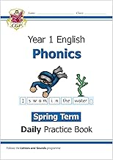
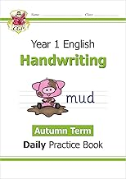
Home Learning
Your children work really hard at school each day!
Aim for a minimum of 3 reads of your Monster Phonics book a week and supplement with other comics, books and magazines
NumBots practice: the more they practice the better their fluency
Our webpage has lots of internet games
and handwriting sheets to enjoy

Slide 20
Volunteers
Volunteers for readers needed
Will need a DBS if you can help out regularly
If you are able to give up any of your time to help us it would be greatly appreciated!
If you have any skills you would like to share – Nature with Nana
If you have any contacts please put us in touch

Slide 21
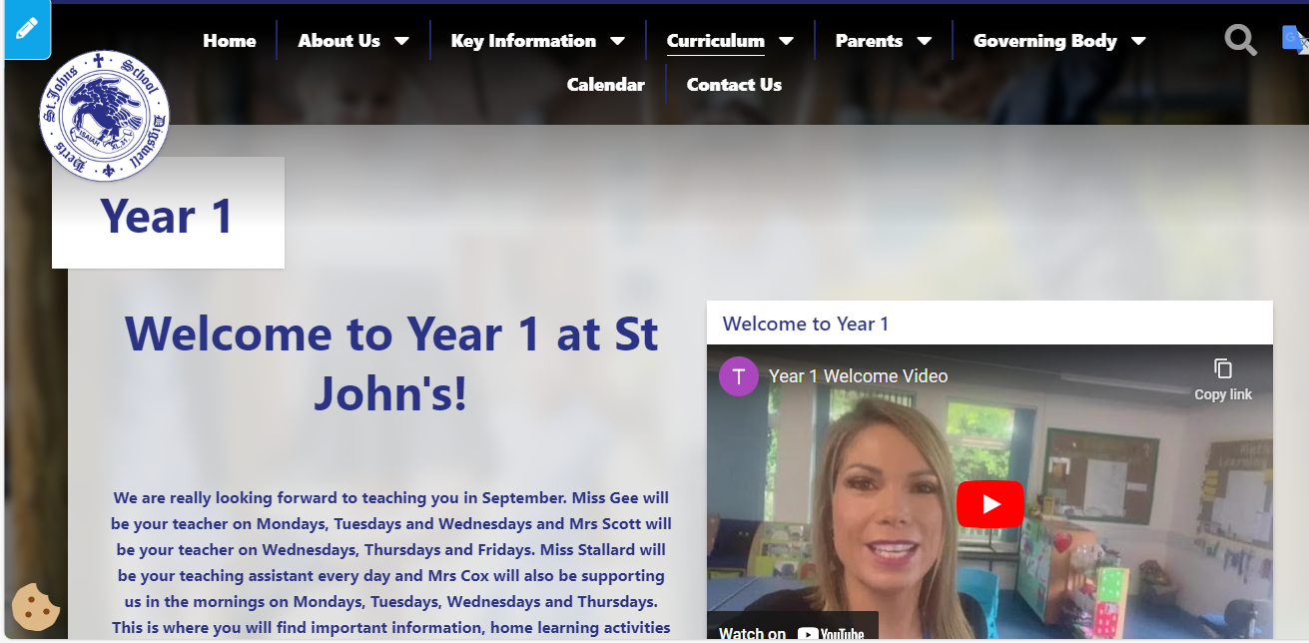
Class Page - https://www.digswell.herts.sch.uk/classes-1

Slide 22
Communication
Please come speak to us any time, after school is always best because we are settling the children in, in the morning
Send an email if you can’t catch us at the end of the day, we can Zoom and call if you are working

Slide 23
Communication
First speak to your class teacher
If not resolved, speak to the Phase Leader:
EYFS/Y1/Y2: Mrs Athill
Y3/4/5/6: Ms Brady
If issue is still not resolved contact the School Office to arrange a meeting with the Head: Mr Wolton-Geer

Slide 24
Thank you!
Any questions?
Any further queries please email us at: admin@digswell.herts.sch.uk

