Slide 1
Welcome!
Year 2
Parent Workshop
September 2025

Slide 2
Year 2 2025
Teacher: Mrs Levy and Mrs Backman
Teaching Assistants: Miss Stallard, Miss Szita and Miss Johnson

Slide 3
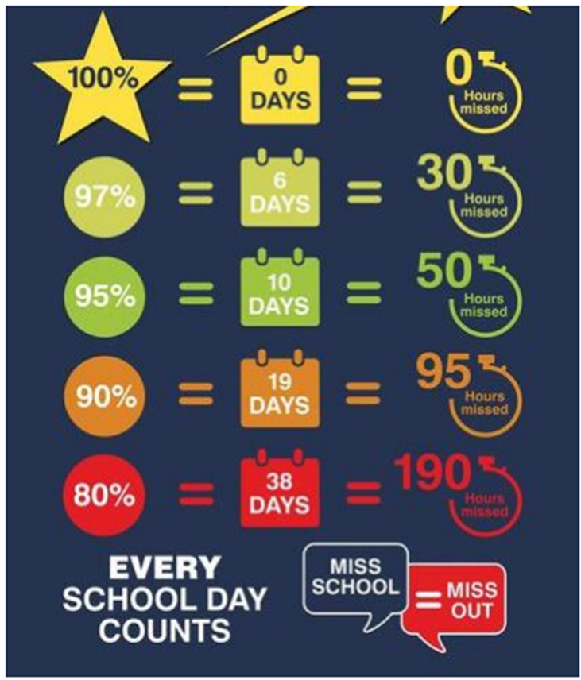
Attendance
Registers close at 8:45am, if your child arrives after then they must enter school through the office
Holidays during school time will
not be authorised
- Attendance is regularly monitored
and you will be contacted by the
school if your child’s attendance
is low

Slide 4
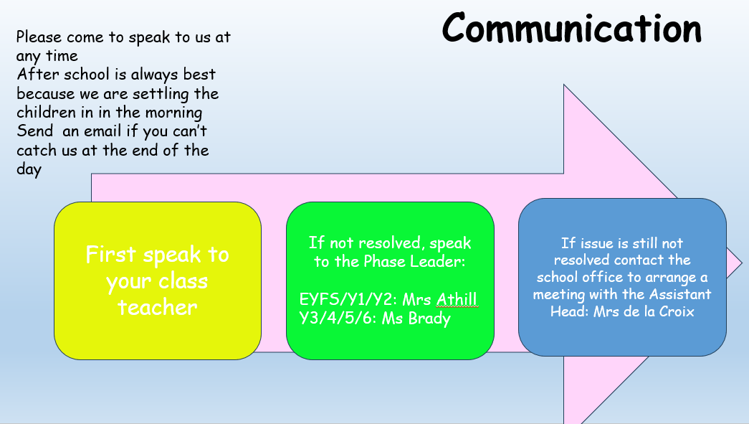

Slide 5
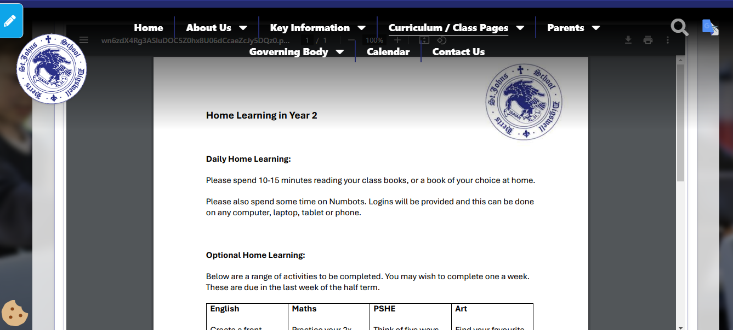
Home Learning
Home Learning has now changed, Google Classroom is no longer in use. All work is now set on our Year 2 page on the school website.
Please see email from last Friday in relation to activities.
No spellings tests, these are now conducted naturally throughout the week.

Slide 6
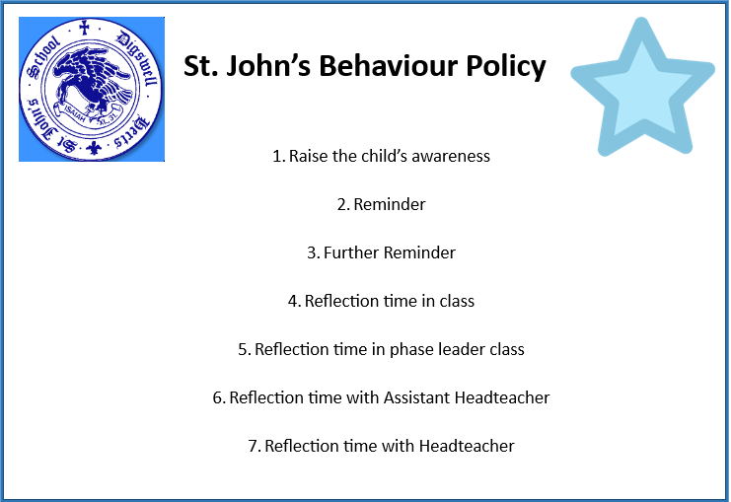

Slide 7
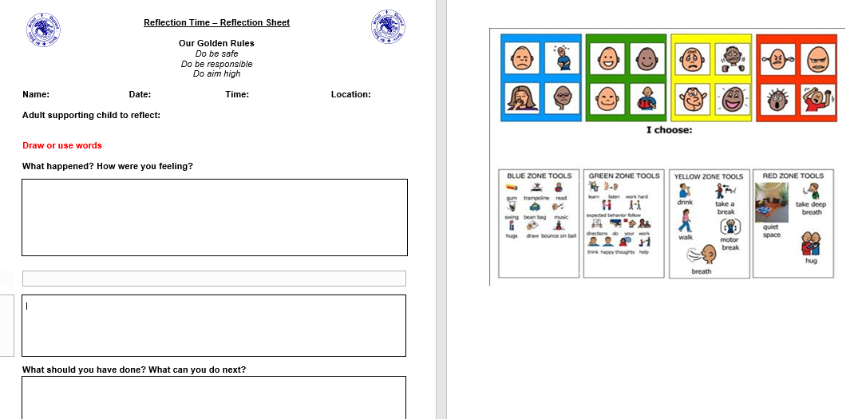

Slide 8
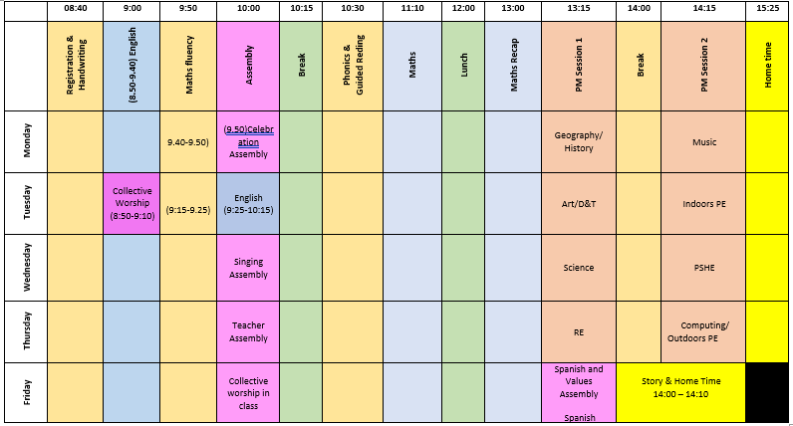

Slide 9

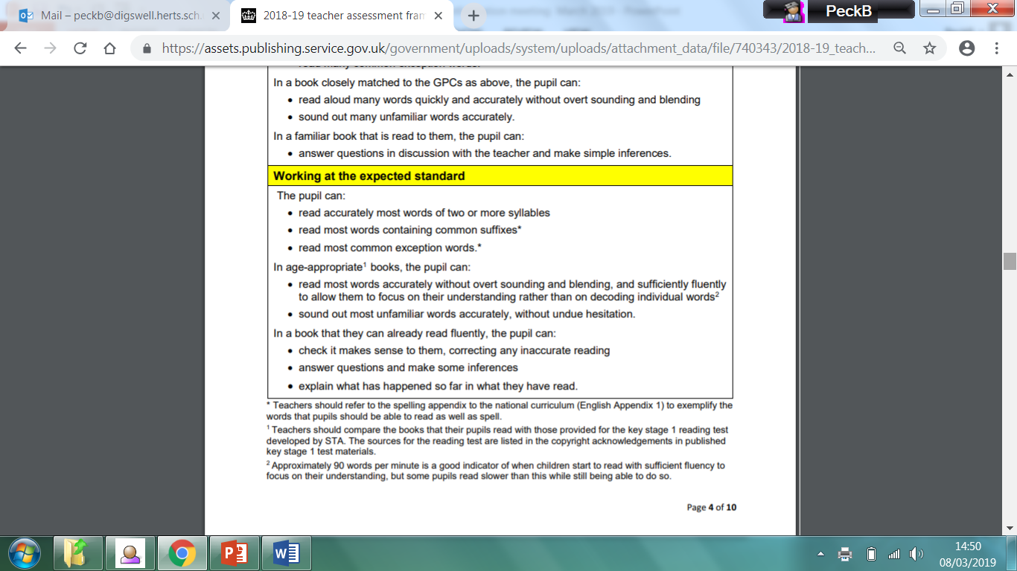
Literacy Skills- Reading
Guided Reading
Your child is heard read twice a week as part of a ‘Guided Reading group’.
A follow up/linked task will be completed by the children after they have read with an adult. This will be linked to comprehension, inference and phonics skills.

Slide 10

Literacy Skills- Reading
Reading at home
When reading with your child at home, it is important to focus on all aspects of the reading process and not just word reading. Children should be encouraged to ask and answer questions about what they have read and make inferences.
Children should have access to a wide range and variety of text types including non- fiction.
Recording their Reading
Boom Reader is our ‘online’ reading record.
It is an opportunity for you to record the range of texts your child is reading at home and any words/skills your child is needing a bit more help with.
It is important to encourage your children to read 3 times a week. Reading books from school can be supplemented with books from home.
https://vimeo.com/832277036?share=copy&turnstile=0.OV_caLPTjyVU8bzK3xs1aANhIUTClTiaAQPYfSOCSryW8teZT9loLq_GIMXxUmcWYMTi-dFn9U9riJ2RuWivUQtb7yR_8ptrMCqZtJEECTavVzQ2ayDYLo--Xz4Kl5xsZfjJhfEHV4Ij6Zx1W4coL4ekqdSsLpJjGsJqSy5CNvNYm_4kcpSyPB4wnx4z4rQ3nRFx3ISoGW5fzSHGafvqOi7ImRPY8dVxuX0lhWllVVuojlfYVAFCiC9DmqgQWWpCtDBBYbo77IA76VNzTFn7l7SJ-XwFeu1I3abg0jL-FMGzzz0uDmNa9L-2J_e9M8atLgaX8JM0BDfdIXtfsRq5McVvLtNglztliNkfLZz2rQFhkOne2Dpk70UiYKHt4KAxASUF8WVKY34w-qCf6ozG_RozcqgIkmy5p-0_n28dD1_1vQu-TUVayYfdWdBi4N9FLAj1mngcPdgdDi-8a007S4q_l-Ytx7UmwxCM1hklP75aNF_t1Mc5YeSylAKzYi_9M_w5Tjz9idDAPASfQYo5BdhyN3WYNYLqR6ql38Je57J4rKlbtMKsUN6Yoc2XdortxxoF3wC0O8aLBps95tQjhMvMnSmMMeFjAM7pVMkjhSptRr-_9XYX-QyrTQrLutbKYw1-RdovdZSBADabgWyeLvAXItaxKXbNT_NiSZZwjP5EXj1IFQoz-y-IRj-sz2OgHAH1-BsUglFnef6R5KlqNRx4hl21rS_9FWQ3u2CWkY0.YfBRzpaz_Ka_vxabz2Jnuw.565e53191d5d081e654379ff06799a853c350cb0f26b667d3c434bd684dfdd2f

Slide 11

Literacy Skills- Writing – Non negotiables
Use continuous cursive script
Correct mistakes with a red pen
Cross out using one neat line
These will be adapted or added to depending on the children's needs.

Slide 12
Literacy Skills- Writing – Non negotiables
Spelling ‘tests’ are now SPAG sessions in school.
There will no longer be set spellings for home learning.
The children will be explicitly taught to spell words from the curriculum in school.

Slide 13
Writing- Grammar
Key grammar for year 2
Conjunctions: or, and, but, when, if, that, because
Adjectives, nouns, expanded/noun phrases- The sharp pencil
Verbs, adverbs- ran quickly
www.theschoolrun.com/primary-grammar-glossary-for-parents

Slide 14

Literacy Skills- Phonics
Phonics at St. John’s is taught in line with the Monster Phonics scheme of work.
Phonics is taught 5 times a week in class.
Year 2 focuses on Phase Six phonics from the letters and sounds scheme.
They should be able to read many familiar words automatically. When they come across unfamiliar words they should in many cases be able to decode them quickly and quietly using their well-developed sounding and blending skills.

Slide 15
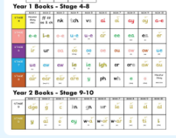
Literacy Skills- Phonics

Slide 16

Literacy Skills - Handwriting
We are using a Continuous Cursive handwriting style.
Cursive writing helps:
Minimise confusion for the child as every letter starts on the line with an entry stroke and leads out with an exit stroke.
It aids the left to right movements through each word across the page and helps develop a child's visual memory.
It helps sequencing and prevents reversals, inversions and omissions.
It aids legibility, especially for those with motor and spatial difficulties, providing a motor training programme.
Form spacing between words as the child develops whole word awareness.
A continuous cursive style of handwriting is recommended by the British Dyslexia Association.
Opportunities for Handwriting
4 times a week in class - modelled by the class teacher.

Slide 17
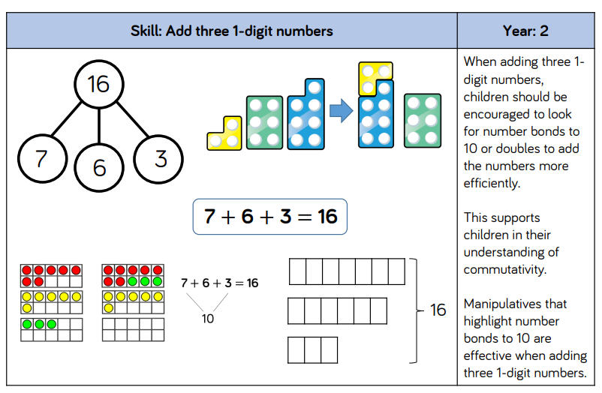
Maths – Addition

Slide 18
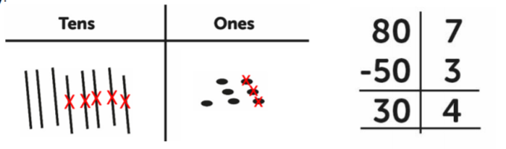
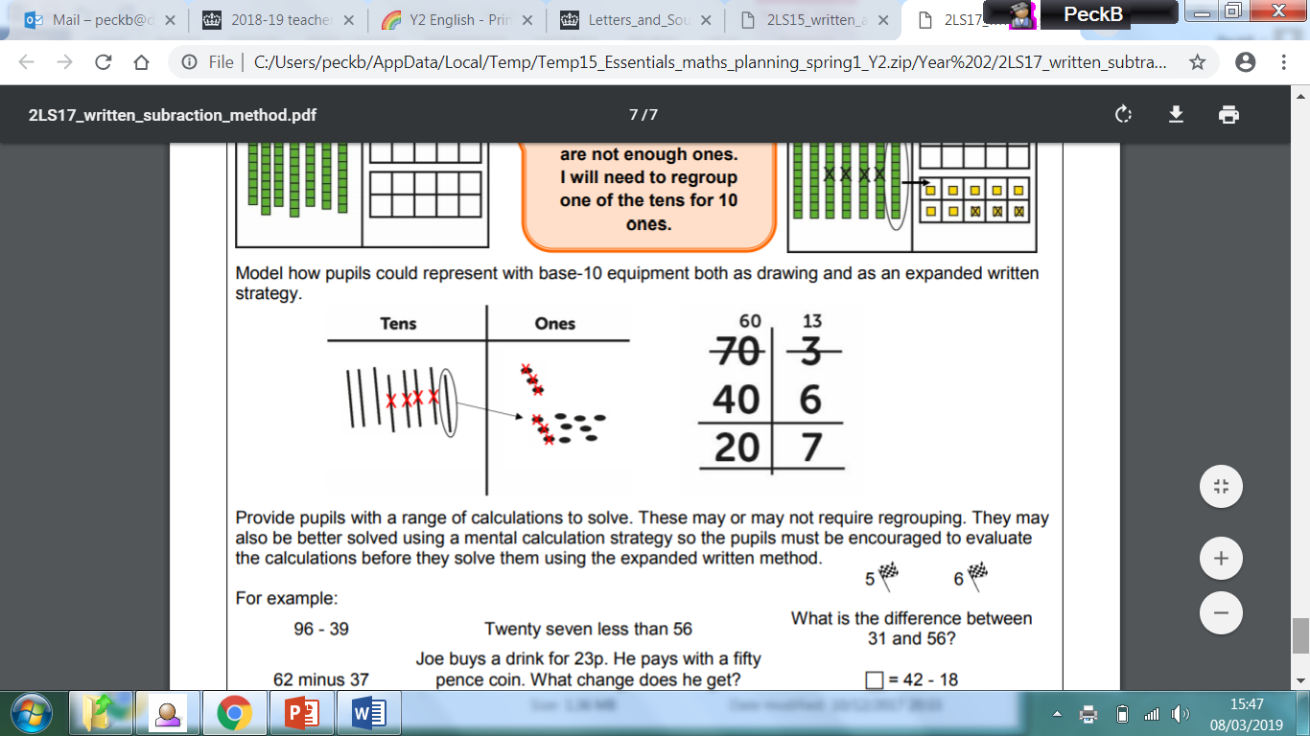
Maths - Subtraction

Slide 19
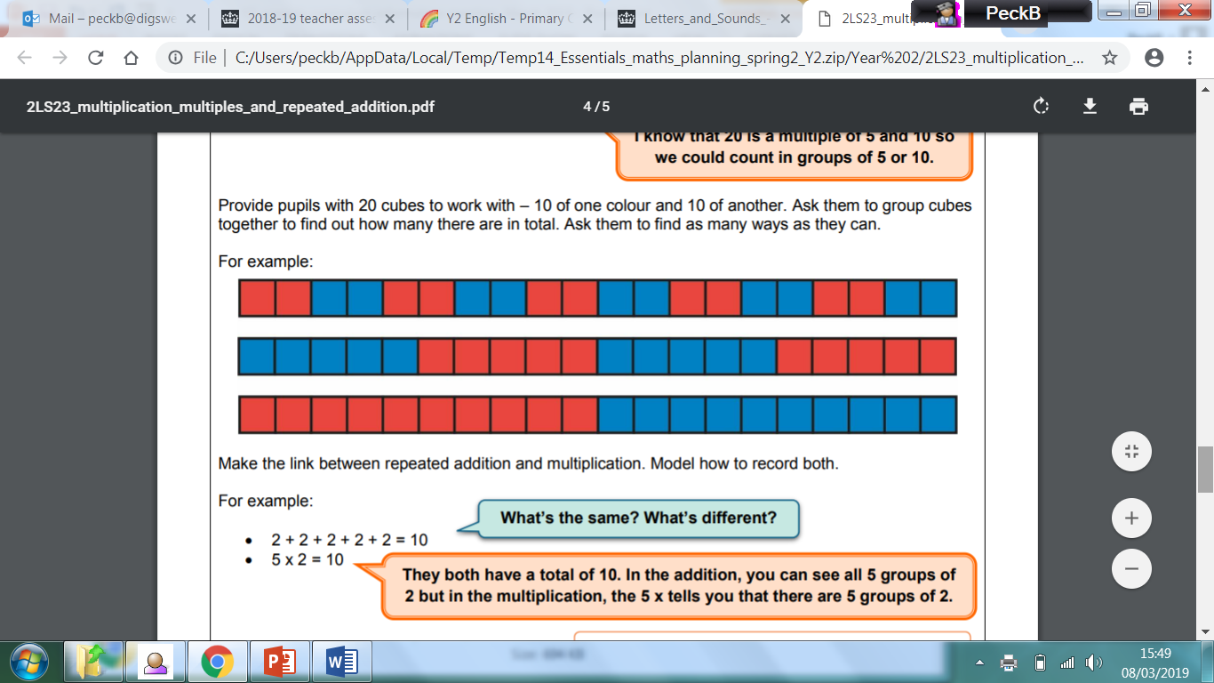
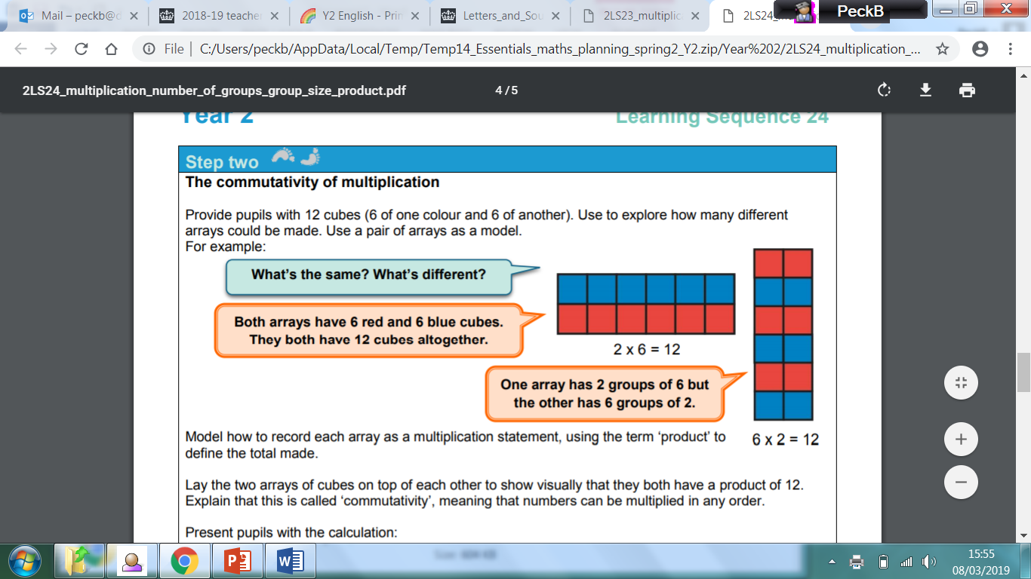
Maths - Multiplication

Slide 20
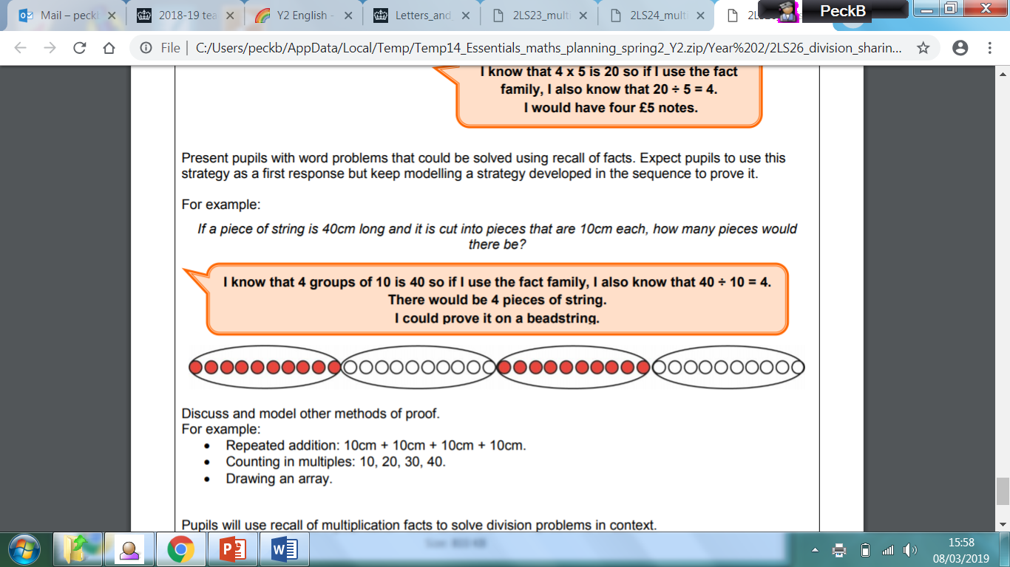
Maths - Division

Slide 21
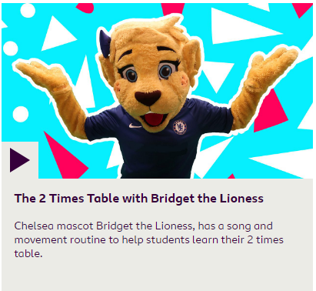
Maths – Times tables
Year 2 Times Table expectations:
All students expected to know 2’s, 5’s and 10’s times tables by end of KS1.
Practice, practice, practice!
Numbots & Times Tables Rockstars
BBC Supermovers, YouTube videos and Times Tables games.

Slide 22
Assessing Progress
Continuous day to day assessments as part of normal
classroom lesson (Assessment for Learning)
Termly assessments in Maths and Literacy
Attainment
Working below age-related expectations
Working at age-related expectations
Working above age-related expectations

Slide 23
Interventions
Lesson plans are flexible and adjusted based on individual needs.
Each lesson, unit and subject may be different.
As a result, individuals or groups may be targeted for further support. These groups will be fluid, flexible and focused.
These individual/group sessions are called Interventions.

Slide 24
Interventions
Through our day-to-day formative assessments, decisions over the weeks ahead will be made as how to best help your child to make progress in their learning.
Interventions that could be used to support your child include:
- Targeted booster/phonics groups
- Writing, Reading and Maths groups
- Social group activities led by familiar and trusted adults
- Additional fine-motor skills/handwriting support
Speech and language support
In most cases, interventions are led by TAs and support staff.

Slide 25
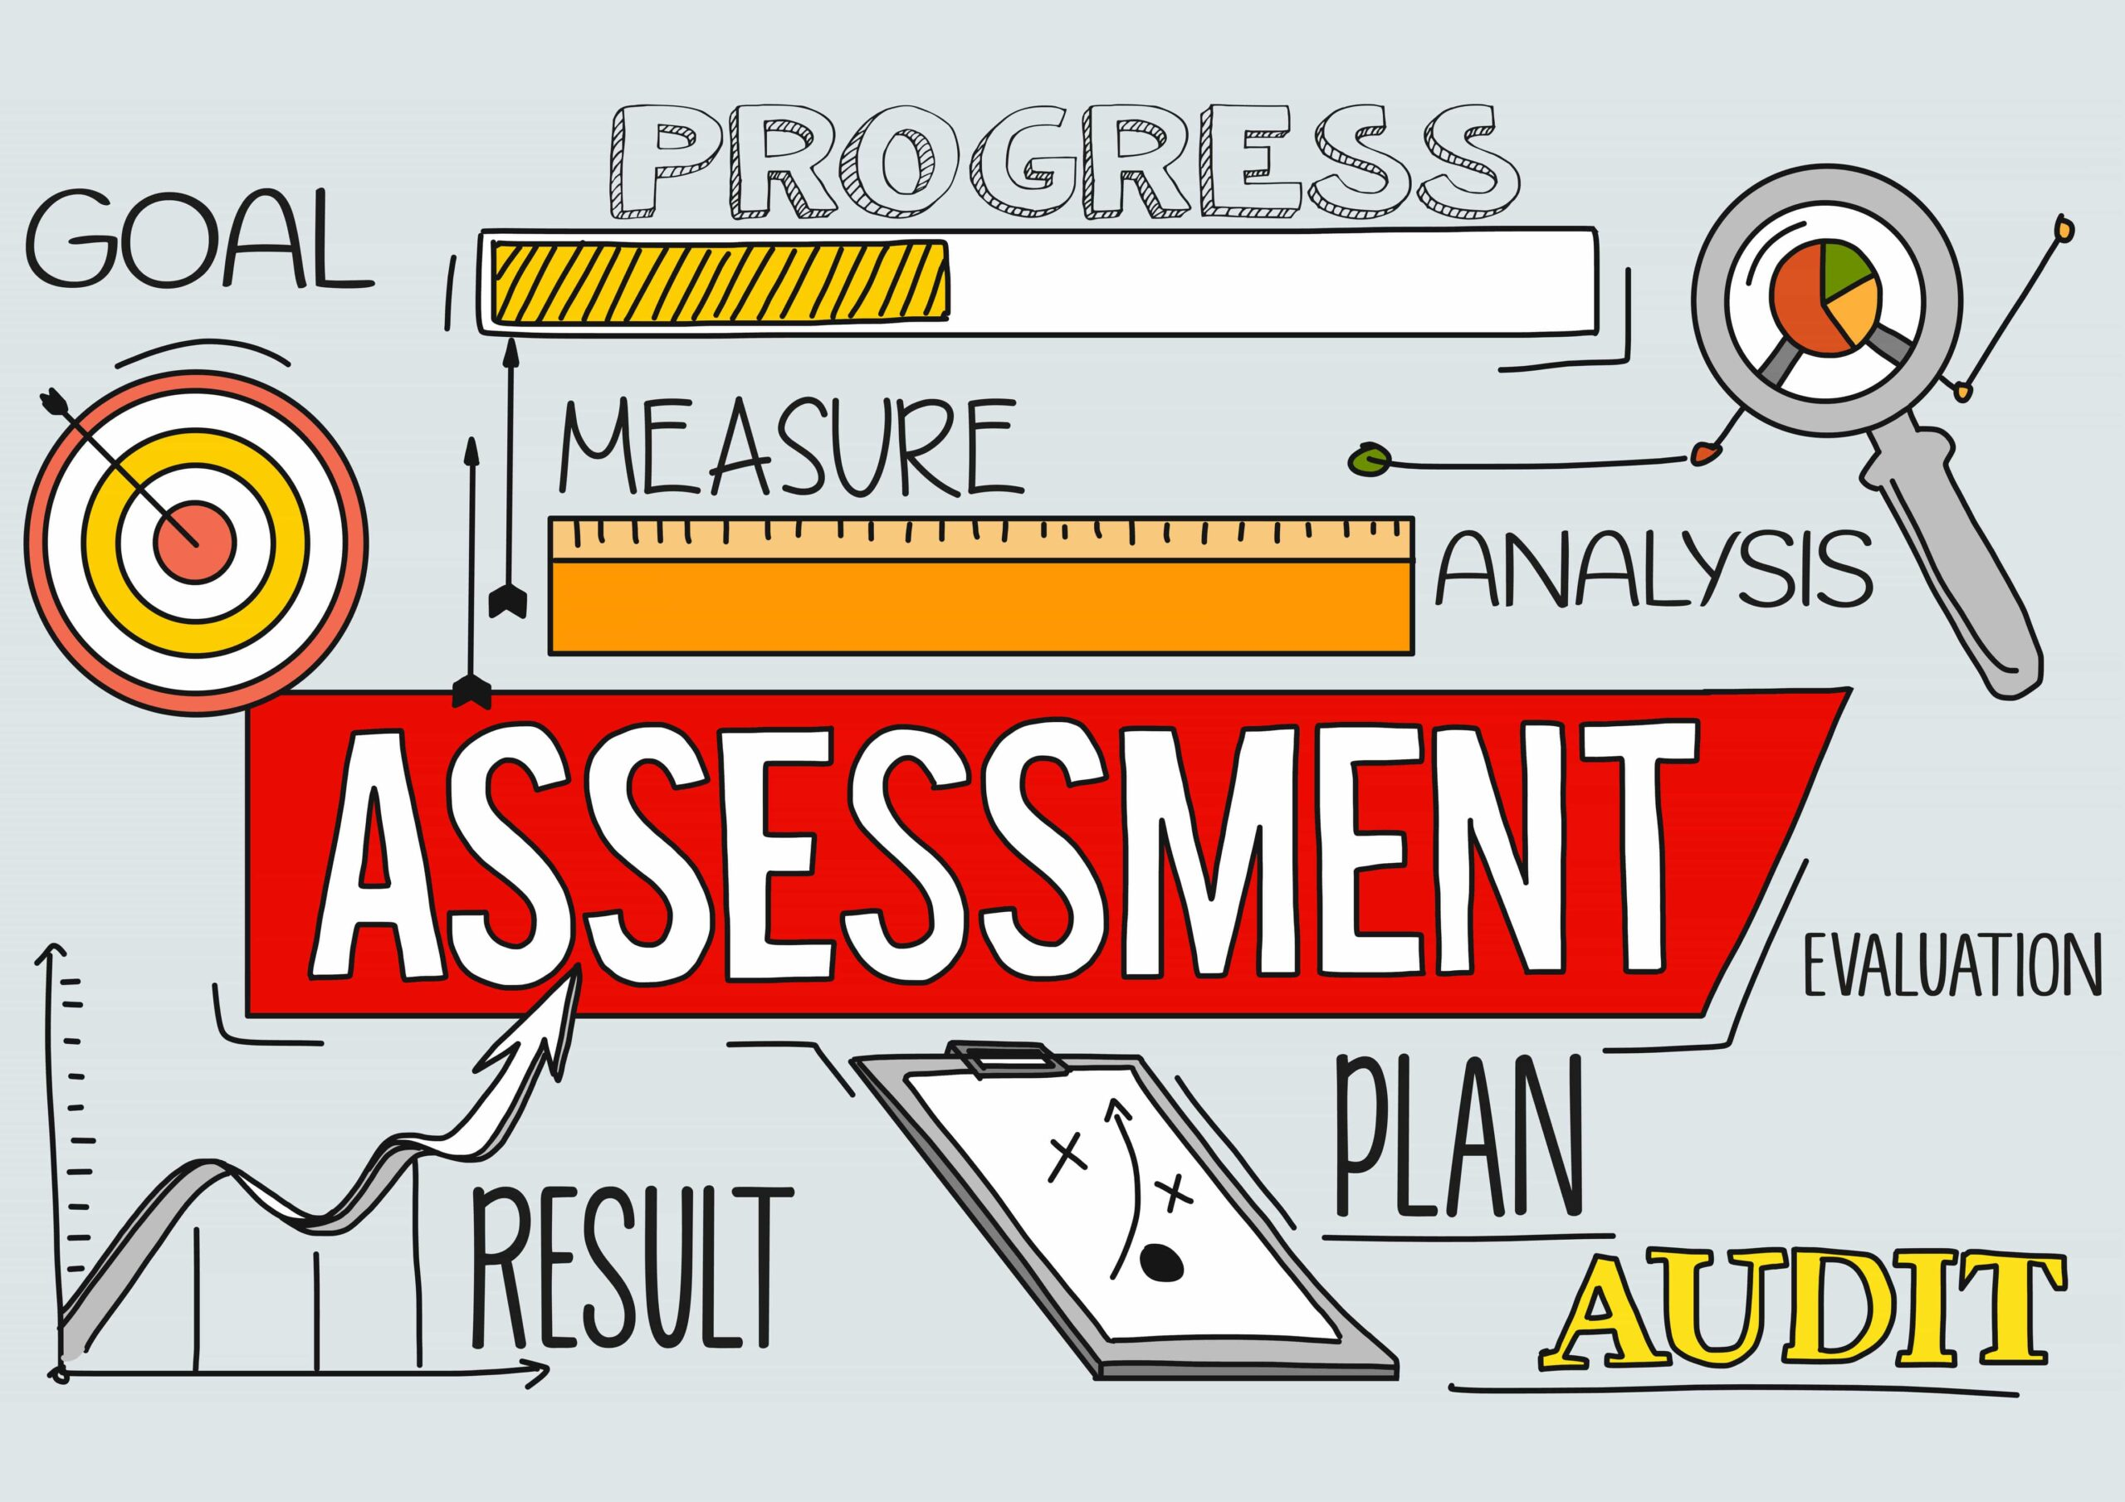
End of KS1 Assessment
Formal SATS papers have now been removed from the end of KS1 assessments.
Children’s progress and attainment will now be carried out via teacher judgement, the same
as any other year group.

