Slide 1

Welcome to
Year 1
High Expectations for All
Soar on wings like an eagle (Isaiah 40:31)

Slide 2

Year 1 staff
Mrs Catherine Scott Monday -Thursday
Mrs Rachel de la Croix - Friday
Mrs Jackie Cox Monday to Thursday – Support Staff
Mrs Precy Pereira – Monday to Friday – Support Staff
Everyone in our school community has the right to
learn, be happy and to feel safe.

Slide 3
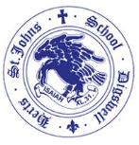
Year 1 approach
Short, whole class teaching sessions
Very similar timetable to Reception during Autumn 1
Lots of movement breaks –jumping, singing, Daily Mile etc
Tutor groups during and Explore More time in Autumn
Learning Challenges for children to show their learning in their own way
Engagement is intrinsically linked to attainment
We have created a Year 1 that is built around the pedagogy of the EYFS - a child-led approach, valuing children as individuals - to ensure a much smoother and quicker transition, while accessing the National Curriculum, but continuing to grow, encourage and reward life-long learning skills needed

Slide 4
Year 1 approach
Start each day with fine motor activities and Guided Reading
After half-term, begin Early Morning Work
Timetable changes significantly over the year, Y1 in July is very different to Y1 in September
Begin learning Spanish weekly, invite you in half termly to hear our songs

Slide 5
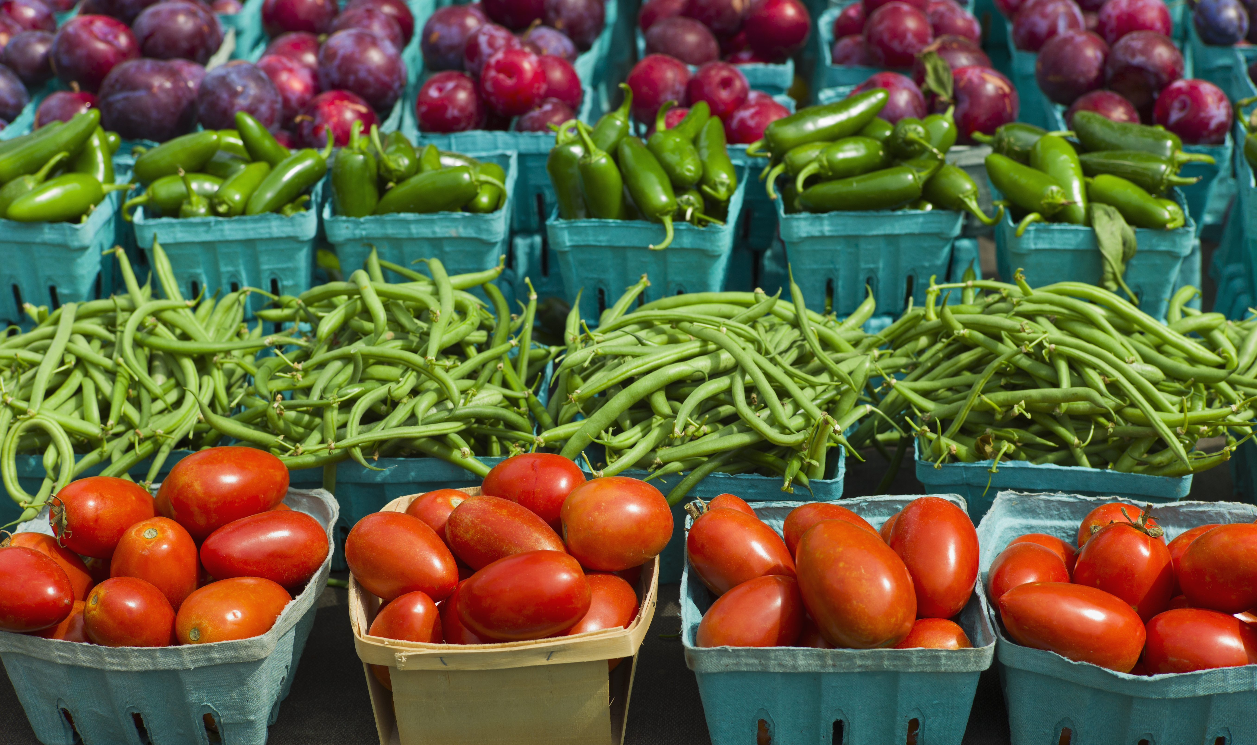
Healthy Snacks
Children do have access to school fruit and milk - if paid for - each morning, however if you would like to pack your child a healthy snack, you can, please make sure it is healthy (fruit, dried fruit, bread sticks, no nuts or ‘may contain nuts’ products)
We have a rolling snack time at the start of the year and
progress to after morning play later in the year
I always let them have a few pieces of fruit
as long as we have enough

Slide 6
Water and toilet
Your child has access to their water bottle all day from the tray, we remind children to put it in the tray each morning. We remind children to drink throughout the day, especially after playtimes and lunchtime. We discourage during whole-class teaching.
Big bottles are helpful, with straws, no squash
Toileting – children are encouraged to use the toilet at playtime and lunchtime, during independent work or transition times. We discourage during whole-class teaching, but would never say no

Slide 7
Summer Activity Book
The Summer Holidays come with many hours
Skills that have been hard earned in Reception can regress
Summer Holiday Adventure Pack for you to complete with your child
One activity to complete each week of the holidays:
-to keep finger muscles and bodies strong
-maintain and improve concentration and focus
Certificate in Celebration Assembly - Please bring back by 11th September
Fun and voluntary – adapt, miss out, still rewarded

Slide 8
Summer Activity Book
Week 1: Over the week play Hide and Seek with the words and sounds attached to this pack
Week 2: Summer Shape Spotter, remember 2D shapes are flat shapes
Week 3: Design a Beach Hut
Week 4: Practise getting dressed and undressed, including shoes, coat, buttons and zips while timed by a stop clock
Week 5: Colour, write and post the addressed postcard your child brings home with this pack –Can you recognise the coins you use to pay for the stamp? Did you get change? What coins did you get? What colour and shape are they? Alternatively, bring it to school by Thursday 11th September
Week 6: Interview an elderly neighbour or relative about the toys they played with as a child. What material were they made from? Do you have a similar toy now?

Slide 9
Reading
Reading assessment in the first week and a new book sent home
Reading and Phonics workshop Wednesday 17th September 2:50-3:20
Please continue to use BoomReader to log your home and school books
Reading folders and books to remain in book bags daily
Build a time into your daily routine to ensure that reading occurs regularly, aim for 5 minutes 5 times a week

Slide 10
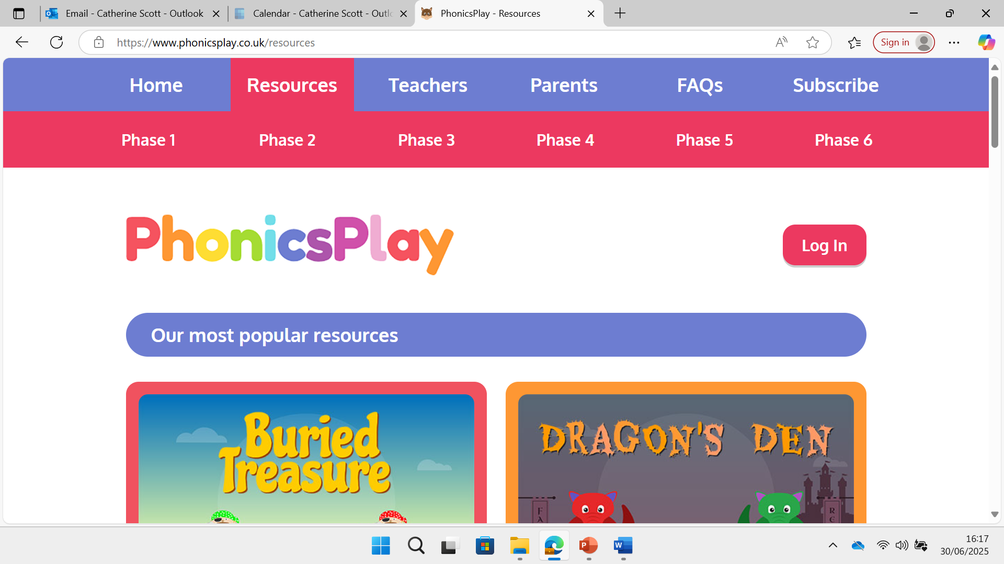
Reading
Supplement with other books – library – pink, red or yellow bands, list on webpage
Later in year your children will begin bringing 2 books home a week
Your child will read the Monster Phonics book twice in school, expect them to read it fairly accurately at home
https://www.phonicsplay.co.uk/resources
Learn the words/sounds that come home today
Webpage link to games

Slide 11
NumBots
Introduction video
Numbots is an online maths learning platform that helps children learn how to add and subtract, improving their fluency and recall in basic mental maths and equipping them with basic maths confidence
Basic number skills are essential building blocks for higher-level maths concepts. NumBots covers number recognition, number bonds and addition and subtraction of double digit numbers; gradually helping your child build a solid conceptual understanding of number sense
We recommend a little and often approach, aim for 3 minutes a day, 4 days a week AND over the summer

Slide 12
Year 1 Phonics
Children will be taught phonics daily through Monster Phonics
4 English lessons a week and Guided Reading rotation daily
Phonics workshop Wednesday 17th September 2:50-3:20
Phonics games on our webpage

Slide 13

Phonics Screening Check PSC
DO NOT STRESS!
Year 1 children take the Phonics Screening Check in the second week of June every year. Please do not book a holiday during this week
The test measures progress in phonics skills and knowledge gained throughout Reception and Year 1. The aim of the screen is to identify children who would benefit from additional support to catch up with their peers at this important early stage
Workshop later in the year – info on webpage

Slide 14
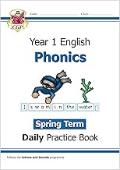
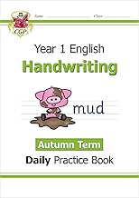

Home Learning
Your children work really hard at school each day
Aim for a minimum of 4 reads a week, 1-2 of your Monster Phonics book and supplement with other comics, books, recipes and magazines
NumBots practise: the more they practise the better their fluency
Our webpage has lots of internet games
and handwriting sheets to enjoy

Slide 15
Volunteers
Volunteers for readers needed
Will need a DBS if you can help out regularly
If you are able to give up any of your time to help us it would be greatly appreciated
If you have any skills/languages/jobs/religions you would like to share – Nature with Nana
If you have any contacts please put us in touch

Slide 16
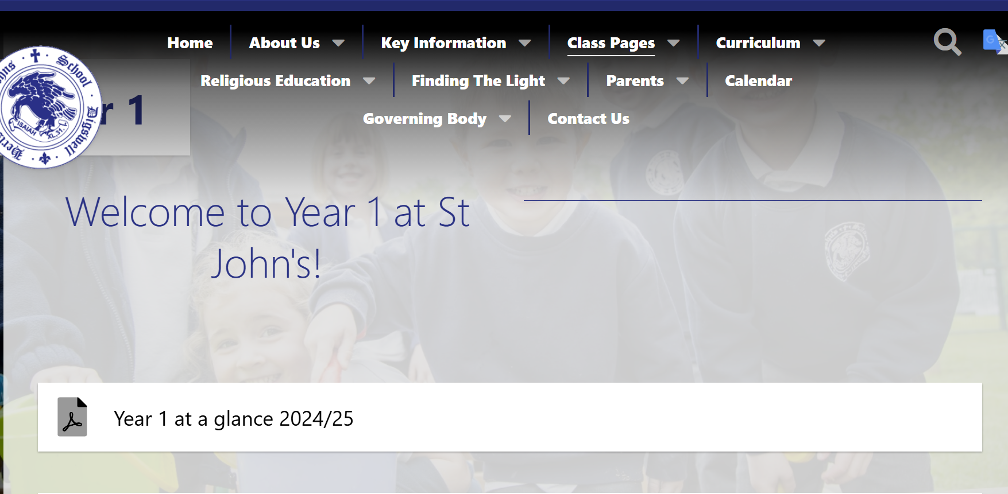
Class Page - https://www.digswell.herts.sch.uk/classes-1

Slide 17
How can you help your child?
Focus and Concentration
Ask your child to complete a small task independently, such as putting their pyjamas on, tidying up, brushing their teeth, putting their shoes on etc, by the time you get back.
Fine motor skills
Children need strong fingers, hands and wrists to write neatly and for sustained periods. Any activity such as drawing, cutting with scissors, playdough, clay, bath crayons, Lego or Duplo etc will help to build stamina and muscles for controlled writing. Peeling bananas and satsumas is also great for fine motor skills and really helpful for snack time at school.

Slide 18
How can you help your child?
All in your Summer Adventure Pack letter
Gross motor skills
Hold competitions to get dressed and undressed in a time frame, visit parks and challenge children to climb and practise holding their own body weight.
Writing
Write post cards, keep a diary, play restaurants and write menus, write place settings for dinner, make invitations, write shopping lists and to do lists etc. Watch your child write, correct letters/numbers that have been written backwards and model correct letter/number formation if they are not forming them correctly.

Slide 19
How can you help your child?
Maths
Use real money and set up a shop at home, talk about and read the days of the week, months of the year, count on and back in 1s from 0-20, then start at a random number and count to 20 and back in 1s from the random number, put post it notes of numbers 1- 20 on the table and match with pasta bits, practise writing numbers, find 1-20 number cards when a number is called out, read number plates etc.

Slide 20
How can you help your child?
Reading
Learning to read for a child is like unlocking a key to a magical universe, making access to the whole National Curriculum easier! We want children to love reading! Let your child see you read, talk about the book you are reading, let them see you read. Hide some of the words/sounds attached to this pack and play, ‘Word/Sound Hide and Seek,’ read and write the words/sounds once found. Visit the library. We have enclosed some Monster Phonics flash cards of words and sounds that your child has learned in Reception, please practise these regularly over the holidays.
Visit the library and borrow non-fiction books on any of the following topics: toys from the past, weather, seasons, animals, bodies, feelings, space, Great Fire of London, materials and plants. Libraries also hold levelled reading books you may like to borrow,these are often colour coded into levelled bands, choose pink, red or yellow level books which equate to Monster Phonics stages 1-3

Slide 21
Communication Reminders
All urgent messages should be communicated to the School Office via telephone or in person on the day
Feel free to pass a note or letter to the member of staff outside on the playground in the morning, first 2 weeks I’ll be out at 8:30am
All non-urgent messages, should be directed via email to the School Office admin@digswell.herts.sch.uk – in the subject heading you can state who you wish the email to be forwarded to
To make an appointment with the us, please email the School Office

Slide 22
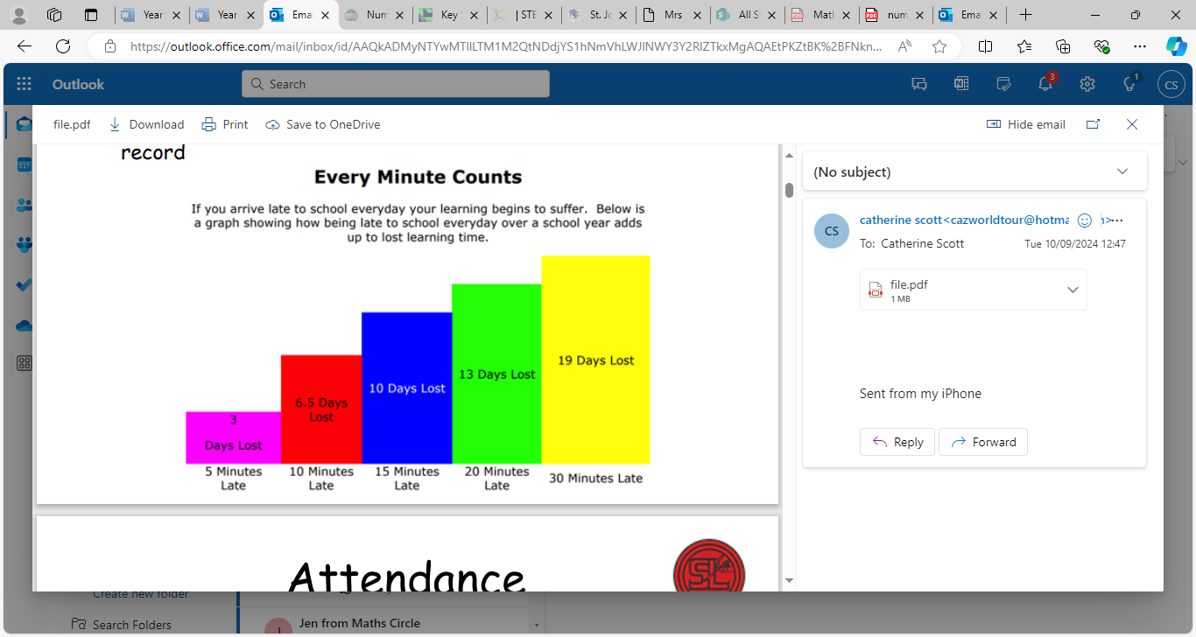
Punctuality
Please ensure you arrive promptly, the registers are open between 8:45am and 8:55am. Line up on the playground at 8:40 when the bell rings and staff will lead the class in
From 8:55am to 9:15am a late mark would be applied and you will need to enter school via the School Office to be marked in
Later than 9:15am is an unauthorised absence
Being late disrupts your child’s learning and attendance record

Slide 23
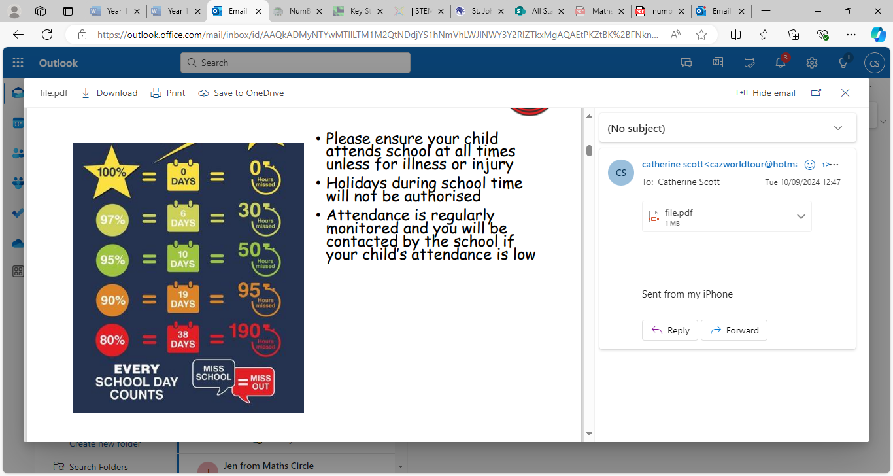
Attendance
Please ensure your child attends school at all times unless for illness or injury
Holidays during school time will not be authorised
Attendance is regularly monitored and you will be contacted by the school if your child’s attendance is low
If you would like to discuss your child’s attendance with school to see how together we can support your child, then please contact the School Office and ask for an appointment with either Mr Worton-Geer (Headteacher) or Mrs de la Croix (Deputy Headteacher and SENCO)

Slide 24
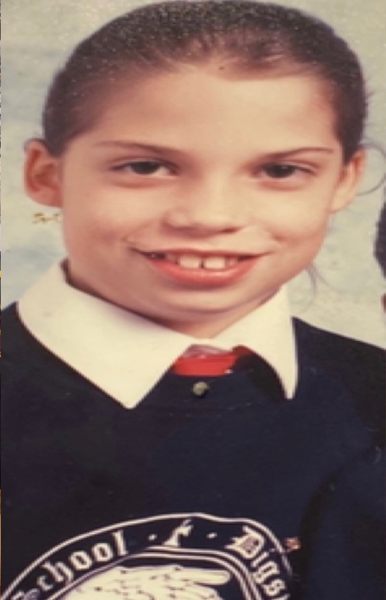
Uniform
Please ensure your child comes to school everyday in the correct uniform - plain black shoes or plain black trainers
Please ensure your child is dressed for the appropriate weather e.g. sun hats/raincoats
Label every piece of clothing
Water bottles to be brought in everyday
Book bags to be brought in everyday with their Monster Phonics book inside
Hair accessories must be plain black, navy, blue or blend in with the child’s natural hair colour – these should also be small and discreet. Hair up if over shoulders

Slide 25
P.E.
PE days are Tuesdays and Thursdays
Please ensure your child comes to school in full P.E. kit
Please name ALL items of clothing
No earrings on P.E. days

Slide 26
Communication
Please come speak to me any time
Send an email if you can’t catch me at the end of the day, we can Zoom and call if you are working
I am where you are, 3 children, youngest Y3, here to support the whole family

