Slide 1
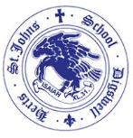

🌟Year 1 approach
👩‍🏫 Short, engaging whole-class teaching sessions
🌱 A timetable closely aligned to Reception during Autumn 1 to support a smooth transition
🔤 Each day begins with Phonics
🤸 Regular movement breaks throughout the day to support concentration, regulation and readiness to learn (including jumping, singing, maths songs, the Daily Mile and Danny Go)
📈 The timetable gradually evolves throughout the year - Year 1 in July looks very different from Year 1 in September, as children become increasingly independent and ready for Key Stage 1 learning.
Children begin learning Spanish each week and families are invited into school most half terms to enjoy sharing the songs and language they have learned
❤️ We maintain a nurturing, play-informed approach, while gradually increasing children's independence, resilience and confidence

Slide 2
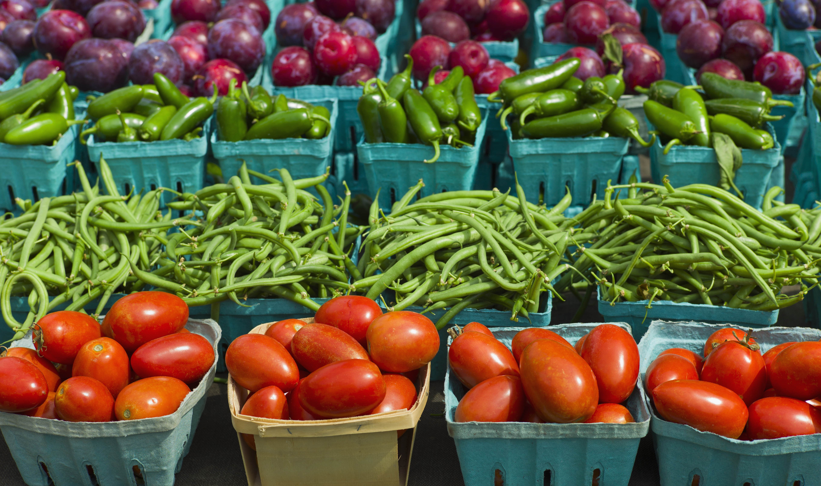
🍎 Healthy Snacks
🍎 School fruit provided daily and milk available (if ordered)
🥕 Healthy snacks may also be sent in (e.g. fruit, dried fruit, breadsticks, crackers or rice cakes)
🚫 No nuts or products labelled 'may contain nuts’
⏰ Rolling snack time in Autumn, moving to morning playtime later in the year
🍓 Children are welcome to have extra fruit if available
🥨 Afternoon snack donations are always appreciated (e.g. breadsticks, crackers or rice cakes)

Slide 3
Water and toilet
💧 Drinks
💦 Water bottles are accessible throughout the day
🥤 Large bottles with straws are recommended
🚫 Water only – no squash
⏰ Children are encouraged to drink regularly, especially after playtimes and lunchtime
👩‍🏫 Drinking during whole-class teaching is discouraged where possible
🚻 Toileting
🚻 Children are encouraged to use the toilet at playtimes, lunchtimes and during independent learning or transition times
👩‍🏫 We discourage toilet trips during whole-class teaching where possible
❤️ However, we would never refuse a child who genuinely needs to go

Slide 4
❤️Behaviour
😊 Everyone in our school community has the right to learn, be happy and feel safe.
7 steps of behaviour (from our Behaviour Policy, available on the school website):
1️⃣ Raise the child's awareness
2️⃣ Reminder
3️⃣ Further reminder
4️⃣ 🤔 Reflection time in class
5️⃣ 👥 Reflection time in Phase Leader's class
6️⃣ 👔 Reflection time with the Deputy Headteacher
7️⃣ 🏫 Reflection time with the Headteacher
⏸️ We WILL NOT take away parts of break times or lunchtimes unless it reaches Stage 6.

Slide 5
☀️Summer Activity Pack
☀️ The summer holidays bring lots of opportunities for fun and learning together!
🌱 Help your child maintain the fantastic skills they developed in Reception.
🗺️ Complete our Summer Holiday Adventure Pack together.
📅 One fun activity each week to:
  ✋ Strengthen finger muscles for writing
  🤸 Encourage independence
  🧠 Develop concentration and focus
  ✏️ Recap Reception learning
🏆 Return completed activities by 10th September to receive a certificate in Celebration Assembly.
❤️ Completely voluntary – adapt activities, miss some out and enjoy them at your own pace. Every child will be rewarded for taking part!

Slide 6
📚Reading
📖 Reading assessment completed during the first week and a
new reading book sent home
👩‍🏫Reading & Phonics Workshop – Wednesday 16th September at 8:50am or 2:50pm (School Hall)
📱Please continue to use BoomReader to log home reading
🎒 Reading folder and reading book to be brought to school every day
🕒 Build reading into your daily routine – aim for 5–10 minutes, 3–5 times each week
⭐ Little and often is best! Just 5 minutes of regular reading has a huge impact on children's confidence, fluency and enjoyment of reading

Slide 7
📚 Reading
📖 Supplement your child's reading with books from home or your local library (look for Pink, Red
or Yellow book bands) also, recipes, comics, magazines, leaflets, non-fiction
👩‍🏫 Most children read in a guided reading group with me once a week, while the remaining children complete a handwriting session
📚 Later in the year, children will begin bringing home two reading books each week
🔤 Your child will have read their Monster Phonics book at least once in school, so they should be able to read it with increasing accuracy and confidence at home
🗂️ Please practise the Monster Phonics words and sounds sent home today
💻 Visit our class webpage for phonics games, handwriting sheets and additional home learning resources
⭐ Remember: Re-reading a familiar book builds fluency, confidence and expression—it's just as important as reading a new book!
❤️ Keep reading aloud to your child. Books that are beyond their independent reading level expose them to richer vocabulary, more complex language and exciting new ideas.

Slide 8
🔢NumBots
Introduction video
🤖 Numbots is our online maths platform, helping children develop confidence with subitizing, addition, subtraction and number fluency.
🧠 Strong number skills are the building blocks for all future maths learning. Numbots develops number recognition, number bonds and mental calculation skills.
⏰ Little and often is best! We recommend 4 minutes, 4 days a week (including during the summer holidays) to build fluency and confidence.
⭐ Regular practise makes a huge difference and helps children access Year 1 maths with greater confidence.

Slide 9
🔤 Year 1 Phonics
🧡 Daily phonics lessons using Monster Phonics
👩‍🏫 Reading & Phonics Workshop – Wednesday 16th September at 8:50am or 2:50pm (School Hall)
📅 Year 1 & 2 Phonics Screening Workshop – Wednesday 20th January at 8:50am
💻 Practise at home using the phonics games on our class webpage and the Monster Phonics website

Slide 10

🔤Phonics Screening Check PSC
😊 DON'T STRESS! The Phonics Screening Check is a short, informal activity that most children really enjoy.
📅 The Year 1 Phonics Screening Check takes place during the week of 14th–18th June 2027. Please avoid booking holidays during this week.
⏱️ The check takes just 5–15 minutes and is completed individually with me.
📖 It assesses the phonics knowledge children have developed throughout Reception and Year 1.
🎯 The purpose is to identify children who would benefit from additional phonics support, ensuring they receive the help they need to become confident readers.
❤️ We prepare the children throughout the year, so by June they are familiar with the format and feel confident.

Slide 11
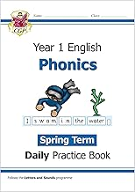

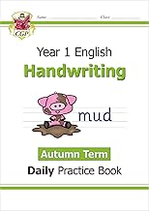
❤️ How You Can Help Your Child Thrive in Year 1
📚 Read together little and often – aim for 3–5 reads each week. Read your child's Monster Phonics book 1–2 times, then enjoy a variety of other books, comics, recipes, magazines or instructions together. You don't need to finish a whole book in one sitting!
💬 Keep reading aloud to your child. Books that are beyond their independent reading level expose them to richer vocabulary, more complex language and exciting new ideas, helping to develop comprehension and a lifelong love of reading.
🤖 Practise Numbots – just 4 minutes, 4 days a week will help develop number fluency and confidence. Little and often really does make a difference!
💻 Make the most of our class webpage, where you'll find phonics games, maths games, handwriting sheets, fine motor activities and lots of ideas for learning at home.
🔬 Explore Developing Experts together to discover exciting Science, Geography and History through videos, quizzes and interactive activities.
⭐ Most importantly... celebrate your child's efforts, encourage their curiosity and enjoy learning together. A positive attitude towards reading and learning is one of the greatest gifts you can give them.

Slide 12
🤝We Love Parent Volunteers!
📖 Volunteers to hear readers are always welcome.
🛡️ A DBS check will be required if you are able to help on a regular basis.
❤️ Any time you can give is hugely appreciated and makes a real difference to our children.
🌍 Do you have a skill, language, hobby, profession or faith that you'd be willing to share? We'd love to hear from you!
🔗 Do you have any community or business contacts? If so, we'd love to be put in touch to help enrich our curriculum and experiences for the children.

Slide 13
❤️ Helping Your Child Become Independent
🏡 Everyday independence builds confidence, resilience and concentration.
Encourage your child to:
👕 Get dressed independently
👟 Put on shoes and coat
👃 Blow their own nose
🧸 Tidy toys away
🍽️ Help set the table
🌦️ Make simple decisions (e.g. "Do I need my jumper?")

Slide 14
How can you help your child?
✏️ Strong hands = better handwriting
Try:
🎨 Drawing and colouring
✂️ Cutting
🧱 Lego or Duplo
🟤 Playdough
🧵 Threading
🍌 Peeling fruit

Slide 15
📚The Biggest Difference You Can Make
📖 Read together every day (5 minutes)
❤️ Keep reading books above your child's reading level to develop vocabulary and comprehension.
📚 Visit the library regularly (Pink, Red and Yellow books are ideal.)
✍️ Encourage purposeful writing:
🛒 Shopping lists
💌 Postcards
🎂 Birthday cards
🍽️ Menus
🗺️ Treasure maps
💬 Talk, talk, talk!
Rich conversations build vocabulary, confidence and understanding.

Slide 16
🔢 Little and Often Wins!
🤖 Play Numbots - ⏰ 4 minutes 📅 4 times a week
💻 Explore together:
🧪 Developing Experts
🌐 Our Class Webpage
🎯 BBC Bitesize
⚡Top Marks - Hit the Button - Maths

Slide 17
⭐ Our Top Three Priorities
🥇 📚 Read together every day
🥈 🤖 Play Numbots (4 minutes, 4 times a week)
🥉 💬 Keep talking! Rich conversations develop vocabulary and support every area of learning.

Slide 18
📧Communication Reminders
📞 Urgent messages should be communicated to the School Office by telephone or in person on the day.
📝 During the first two weeks, I'll be on the playground from 8:30am, so please feel free to pass me a quick note or have a quick chat.
📩 Non-urgent messages should be emailed to the School Office: admin@digswell.herts.sch.uk
✉️ Please include the member of staff's name in the subject line, and your email will be forwarded.
🤝 To arrange a meeting with me, please contact the School Office by email.

Slide 19
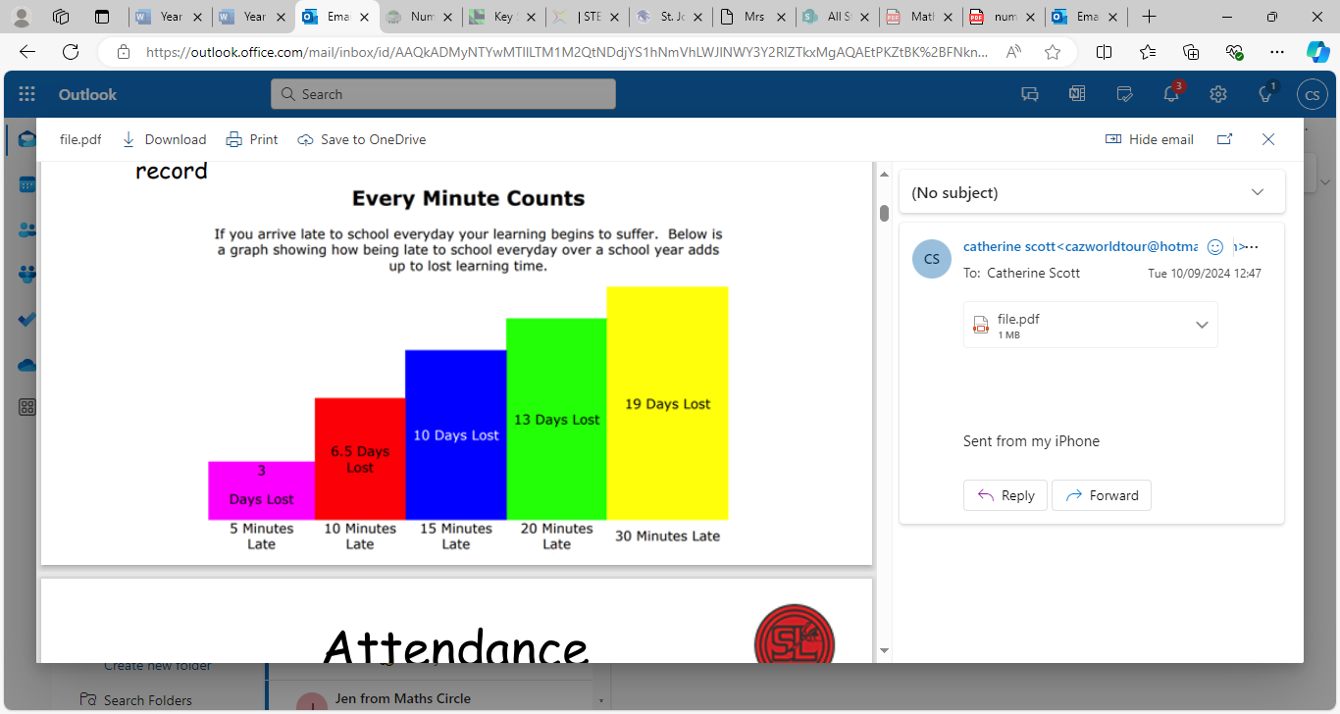
⏰ Arriving at School🏫
🏫 Please arrive promptly for the start of the school day at 8:40am.
♟️Line up on the playground by the chess board – registers are taken at 8:40am.
🚪If you arrive after 8:40am, please enter via the School Office.
📝Children arriving after registration, but before 9:10am, will be signed into the Late Book and you will be asked to provide a reason for the lateness.
⏰The register closes at 9:10am. Children arriving after this time will be marked as absent for that session.
⭐ Arriving on time helps your child settle quickly, maximises learning time and supports a positive attendance record.

Slide 20
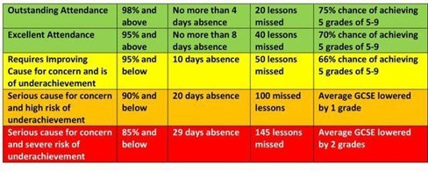
📅 Attendance Matters
🎒 Please ensure your child attends school every day unless they are unwell or injured.
🌴 Holidays during term time cannot be authorised.
📊 Attendance is monitored regularly. If your child's attendance becomes a concern, the school will contact you to offer support.
🤝 If you would like to discuss your child's attendance, please contact the School Office to arrange an appointment with:
  👨‍🏫 Mr Worton-Geer (Headteacher), or
  👩‍🏫 Mrs de la Croix (Deputy Headteacher & SENCO)
⭐ Excellent attendance helps children build confidence, maintain friendships and make the best possible progress.

Slide 21
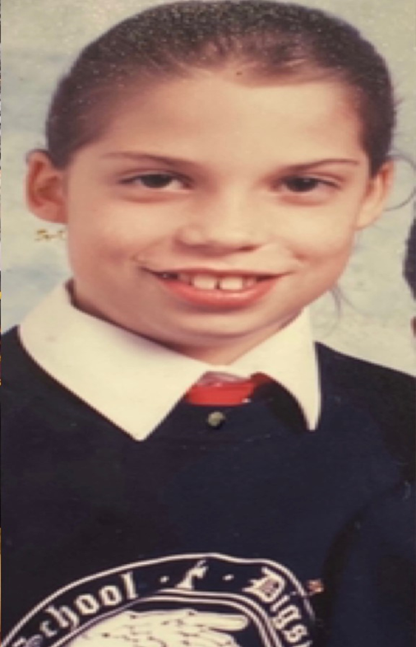
👕 Uniform & Clothing
👕 Please ensure your child comes to school every day in the correct school uniform, including plain black shoes or plain black trainers.
☀️🌧️ Dress your child for the weather (e.g. sun hats, raincoats and warm coats) – Opal play takes place in all weathers.
🏷️ Please label every item of clothing.
🎀 Hair accessories should be plain black, navy, blue or match your child's natural hair colour. They should be small and discreet and long hair should be tied back.
🎒 What to Bring Each Day
💧 A named water bottle
📚 A book bag with your child's Monster Phonics reading book inside
🧦 A spare pair of socks and trousers in their bag
👢 Named wellies can be left at school

Slide 22
🏃‍♀️ Physical Education (P.E.)
🗓️P.E. lessons take place on Tuesdays and Thursdays.
👕 Please ensure your child comes to school wearing their full P.E. kit on these days.
🏷️ Please name ALL items of clothing.
💎 No earrings should be worn on P.E. days.

Slide 23
❤️ We're a Team
Please come and speak to me whenever you need to – no problem is too small.
📧 If you can't catch me at the end of the day, please send an email via the School Office. We can arrange a phone call, Zoom or Teams meeting if that's easier around work commitments.
👨‍👩‍👧‍👦 I'm a parent too, with three children (my youngest is in Year 4), so I understand the joys and challenges that family life can bring.
🤝 I'm here to support not just your child, but your whole family.
❤️ We achieve the very best outcomes when we work together.

