Slide 1

Welcome to
Year 2
Finding the light in ourselves and each other
Inspired by John (8:12)

Slide 2

Year 2 staff
Miss Coleman
Mrs Bernaux – All Week – Support Staff
Mr Norris – Monday-Wednesday – Support Staff
Mrs Periera – Learning Support Assistant
Everyone in our school community has the right to
learn, be happy and to feel safe.

Slide 3
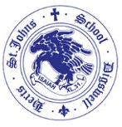
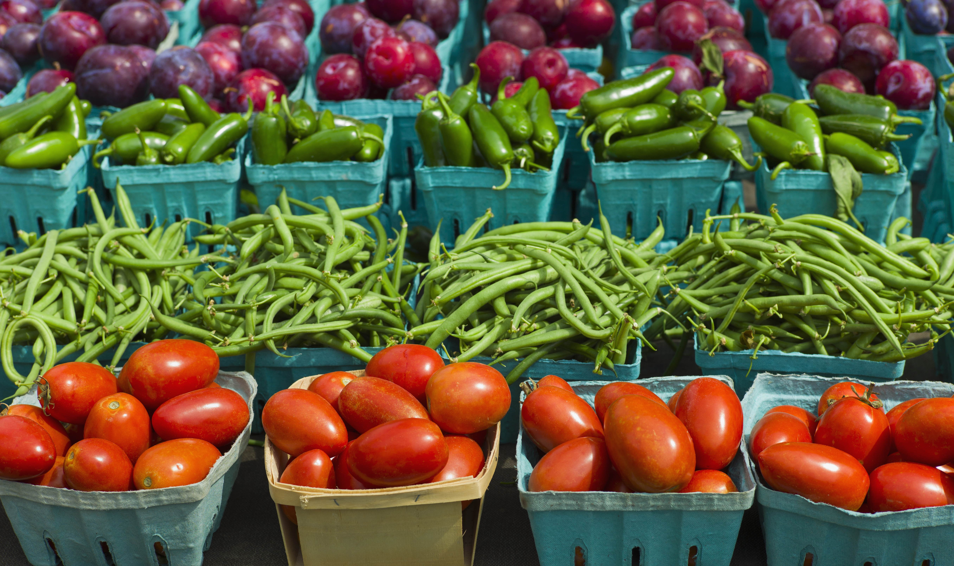
🍎 Healthy Snacks
🍎 School fruit provided daily and milk available (if ordered)
🥕 Healthy snacks may also be sent in (e.g. fruit, dried fruit, breadsticks, crackers or rice cakes)
🚫 No nuts or products labelled 'may contain nuts’
🍓 Children are welcome to have extra fruit if available
🥨 Afternoon snack donations are always appreciated (e.g. breadsticks, crackers or rice cakes)
Please make sure that fruit is cut!

Slide 4
Water and toilet
💧 Drinks
💦 Water bottles are accessible throughout the day
🥤 Large bottles with straws are recommended
🚫 Water only – no squash
⏰ Children are encouraged to drink regularly, especially after playtimes and lunchtime
🚻 Toileting
🚻 Children are encouraged to use the toilet at playtimes, lunchtimes and during independent learning or transition times
👩‍🏫 We discourage toilet trips during whole-class teaching where possible
❤️ However, we would never refuse a child who genuinely needs to go

Slide 5
❤️Behaviour
😊 Everyone in our school community has the right to learn, be happy and feel safe.
7 steps of behaviour (from our Behaviour Policy, available on the school website):
1️⃣ Raise the child's awareness
2️⃣ Reminder
3️⃣ Further reminder
4️⃣ 🤔 Reflection time in class
5️⃣ 👥 Reflection time in Phase Leader's class
6️⃣ 👔 Reflection time with the Deputy Headteacher
7️⃣ 🏫 Reflection time with the Headteacher
⏸️ We WILL NOT take away parts of break times or lunchtimes unless it reaches Stage 6.

Slide 6
📧Communication Reminders
📞 Urgent messages should be communicated to the School Office by telephone or in person on the day.
📩 Non-urgent messages should be emailed to the School Office: admin@digswell.herts.sch.uk
✉️ Please include the member of staff's name in the subject line, and your email will be forwarded.
🤝 To arrange a meeting with me, please contact the School Office by email.

Slide 7
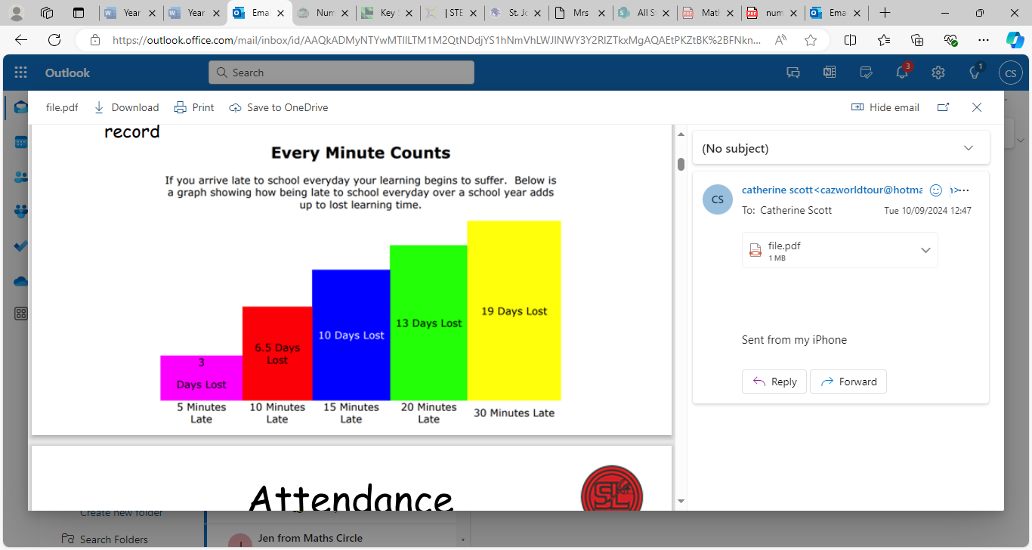
⏰ Arriving at School🏫
🏫 Please arrive promptly for the start of the school day at 8:40am.
🚪If you arrive after 8:40am, please enter via the School Office.
📝Children arriving after registration, but before 9:10am, will be signed into the Late Book and you will be asked to provide a reason for the lateness.
⏰The register closes at 9:10am. Children arriving after this time will be marked as absent for that session.
⭐ Arriving on time helps your child settle quickly, maximises learning time and supports a positive attendance record.

Slide 8
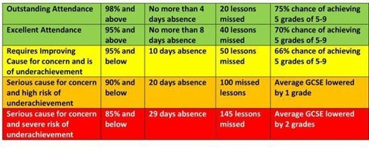
📅 Attendance Matters
🎒 Please ensure your child attends school every day unless they are unwell or injured.
🌴 Holidays during term time cannot be authorised.
📊 Attendance is monitored regularly. If your child's attendance becomes a concern, the school will contact you to offer support.
🤝 If you would like to discuss your child's attendance, please contact the School Office to arrange an appointment with:
  👨‍🏫 Mr Worton-Geer (Headteacher), or
  👩‍🏫 Mrs de la Croix (Deputy Headteacher & SENCO)
⭐ Excellent attendance helps children build confidence, maintain friendships and make the best possible progress.

Slide 9
👕 Uniform & Clothing
👕 Please ensure your child comes to school every day in the correct school uniform, including plain black shoes or plain black trainers.
☀️🌧️ Dress your child for the weather (e.g. sun hats, raincoats and warm coats) – Opal play takes place in all weathers.
🏷️ Please label every item of clothing.
🎀 Hair accessories should be plain black, navy, blue or match your child's natural hair colour. They should be small and discreet and long hair should be tied back.
🎒 What to Bring Each Day
💧 A named water bottle
📚 A book bag with your child's Monster Phonics reading book inside
🧦 A spare pair of socks and trousers in their bag
👢 Named wellies can be left at school

Slide 10
👕 PE Kit – September 2026
🔵 We are moving to NAVY tops for PE instead of white - white or navy this year, but NAVY only September 2027
👕 Tops can be a plain navy T-shirt, or a navy top with the school logo from Smarties
👕 School jumper or fleece when it is cold
🩳 Shorts or joggers should be navy or black
👟 Please make sure children have suitable trainers for PE and that all items are clearly named
❤️ Thank you for helping us keep PE kit simple, practical and consistent across the school
All jewellery must be removed and at the very least studs must be covered up with masking tape during PE lessons. If children are wearing jewellery, they must be able to remove jewellery and put it back in independently
NAVY

Slide 11
🚶‍♀️🚲 Active Travel to School
🌿 Where possible, we encourage families to walk, cycle or scoot to school
❤️ It is a great way to build healthy habits, independence and daily activity
🌍 Fewer car journeys around school also help reduce congestion and improve our local environment
🛴 Children may bring bikes or scooters to school and should use appropriate safety equipment
🚗 If you need to drive, consider parking a little further away and walking the final part of the journey

Slide 12
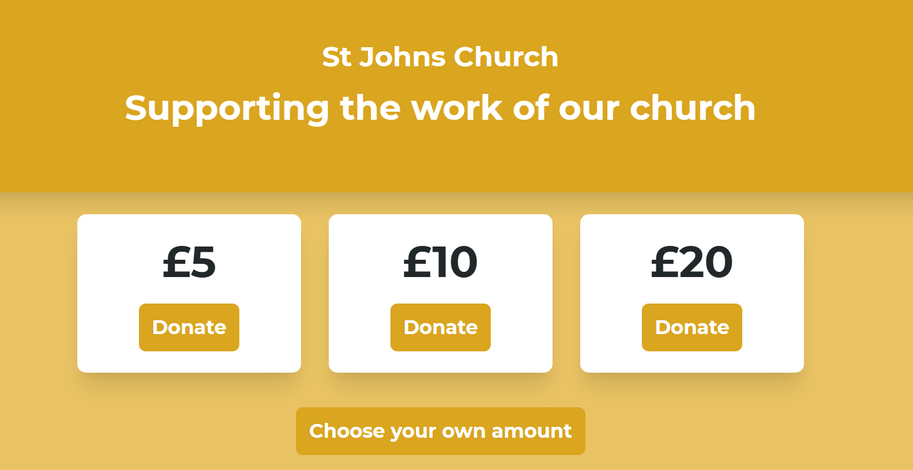
⛪ Our Church School Community
❤️ Being a Church of England school is an important part of the life and ethos of St John’s
🤝 We are proud of our close partnership with Digswell Parish and encourage families to get involved in church and joint school–church events
📰 Look out for ‘Parish News’ in our fortnightly school newsletter for services, events and ways to join in
💛 Families who wish to support the work of St John’s Church can also use the online giving link shared by the school
Online giving – £5, £10, £20 or choose your own amount
Open online giving link

Slide 13
💷 Free School Meals & Pupil Premium
If your financial circumstances change at any point, please check whether your child is eligible.
📝 How to apply
• Apply online through Hertfordshire County Council.
• Have your National Insurance number or Home Office number ready.
• It takes around 5 minutes and eligibility can often be confirmed straight away.
🍽️ What it could mean for you
• Your child may qualify for free school meals and other linked support.
• Even in Reception, Year 1 or Year 2, please still register if you may be eligible — infant meals are already free, but registration can unlock additional support.
🌟 What it could mean for school
• Some eligible children also attract Pupil Premium funding.
• For 2026–27 this is £1,550 per eligible primary-aged pupil.
• Schools use this funding to improve outcomes — for example through teaching support, interventions, resources and wider opportunities.
❤️ Please apply whenever your circumstances change — there is no disadvantage to checking.
Hertfordshire County Council: Free school meals and other benefits | GOV.UK: Pupil Premium 2026–27

Slide 14
🌟Year 2 approach
👩‍🏫 Short, engaging whole-class teaching sessions of approximately 45 minutes, with activities varied to maintain engagement, build independence and support all learners.
📚 A broad and balanced curriculum with an increased emphasis on foundation subjects, allowing children to develop their knowledge and skills across the wider curriculum.
💻 Foundation subjects are taught regularly throughout the week, including weekly sessions in subjects such as Computing, Art, Geography, History, RE, Music and PE, ensuring children experience a rich and varied curriculum.
🧠 Children are encouraged to become increasingly independent learners, developing their confidence, resilience, organisation and ability to reflect on their own learning.
🏃 Movement and active learning continue to be embedded throughout the day, with opportunities to support concentration, regulation, wellbeing and readiness to learn.
🌟 We continue to maintain a nurturing, engaging and child-centred approach, while gradually increasing children's independence, responsibility and readiness for the next stage of Key Stage 1.]

Slide 15
📚Reading
📖 All children have read with an adult to check their understanding from Y1. We will revisit some books from the end of Y1 to ensure that those skills are still embedded.
📱Please continue to use BoomReader to log home reading
🎒 Reading book to be brought to school every day.
🕒 Build reading into your daily routine – aim for 5–10 minutes, 3–5 times each week
⭐ Little and often is best! Just 5 minutes of regular reading has a huge impact on children's confidence, fluency and enjoyment of reading

Slide 16
📚 Reading
📖 Supplement your child's reading with books from home or your local library (look for Pink, Red
or Yellow book bands) also, recipes, comics, magazines, leaflets, non-fiction
👩‍🏫 Most children read in a guided reading group with me once a week, while the remaining children complete a handwriting session or comprehension activity.
📚 Over the next two weeks, children will begin bringing home two reading books each week
🔤 Your child will have read their Monster Phonics book at least once in school, so they should be able to read it with increasing accuracy and confidence at home
⭐ Remember: Re-reading a familiar book builds fluency, confidence and expression—it's just as important as reading a new book!
❤️ Keep reading aloud to your child. Books that are beyond their independent reading level expose them to richer vocabulary, more complex language and exciting new ideas.

Slide 17
🔢NumBots
🤖 Numbots is our online maths platform, helping children develop confidence with subitizing, addition, subtraction and number fluency.
🧠 Strong number skills are the building blocks for all future maths learning. Numbots develops number recognition, number bonds and mental calculation skills.
⏰ Little and often is best! We recommend 4 minutes, 4 days a week (including during the summer holidays) to build fluency and confidence.
⭐ Regular practise makes a huge difference and helps children access Year 1 maths with greater confidence.

Slide 18
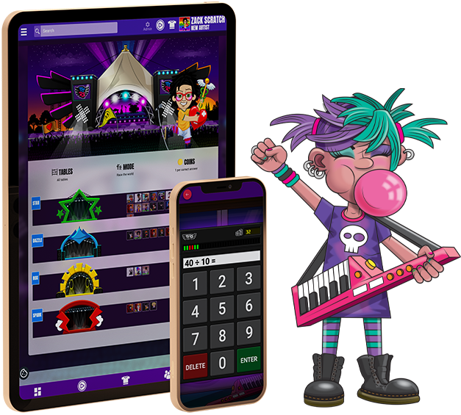
🔢Times Table Rockstars
🤖 Later in the term, we will begin to look at our times tables!
In Year 2, we learn the 2, 5 and 10 times tables.
Your Numbots login will be the same login for TTRockstars.

Slide 19
🔤 Year 2 Phonics
🧡 Daily phonics lessons using Monster Phonics
📅 Year 1 & 2 Phonics Screening Workshop – Wednesday 20th January at 8:50am
💻 Practise at home using the phonics games on our class webpage and the Monster Phonics website

Slide 20
🤝We Love Parent Volunteers!
📖 Volunteers to hear readers are always welcome.
🛡️ A DBS check will be required if you are able to help on a regular basis.
❤️ Any time you can give is hugely appreciated and makes a real difference to our children.
🌍 Do you have a skill, language, hobby, profession or faith that you'd be willing to share? We'd love to hear from you!
🔗 Do you have any community or business contacts? If so, we'd love to be put in touch to help enrich our curriculum and experiences for the children.

Slide 21
📚The Biggest Difference You Can Make
📖 Read together every day (5 minutes)
❤️ Keep reading books above your child's reading level to develop vocabulary and comprehension.
📚 Visit the library regularly (Pink, Red and Yellow books are ideal.)
✍️ Encourage purposeful writing:
🛒 Shopping lists
💌 Postcards
🎂 Birthday cards
🍽️ Menus
🗺️ Treasure maps
💬 Talk, talk, talk!
Rich conversations build vocabulary, confidence and understanding.

Slide 22
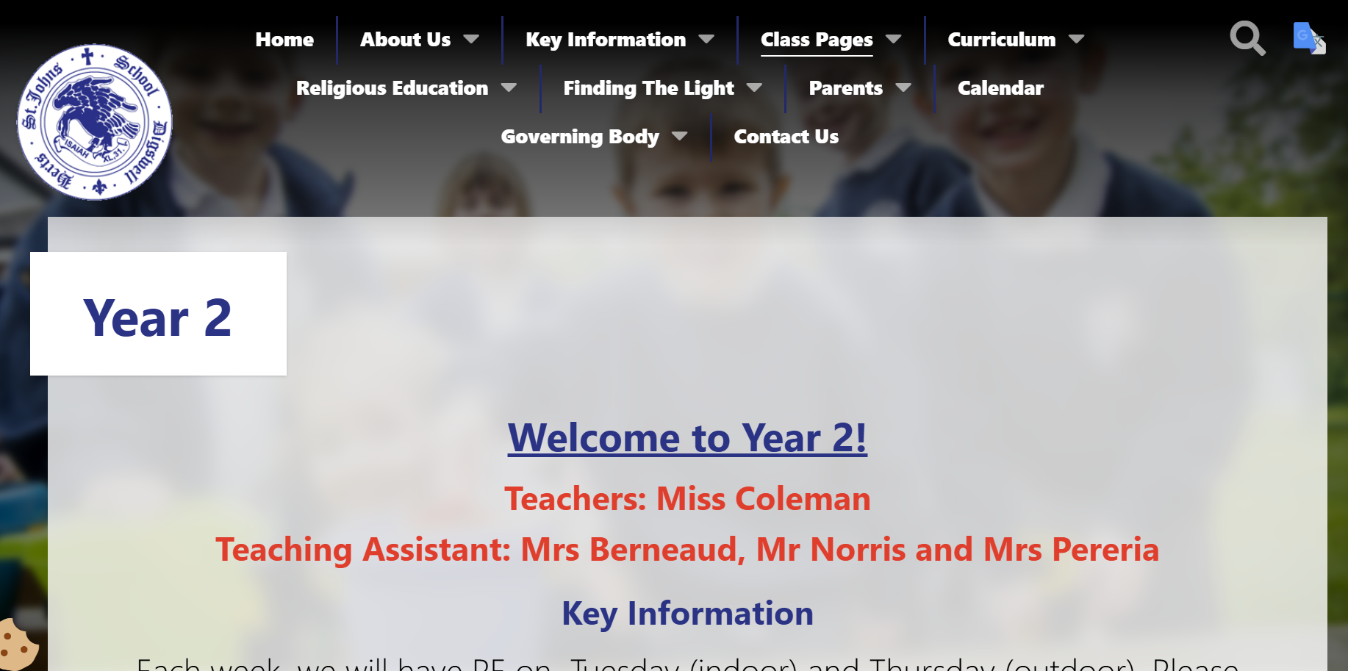
Class Page - https://www.digswell.herts.sch.uk/classes-2

Slide 23
❤️ We're a Team
Please come and speak to me whenever you need to – no problem is too small.
📧 If you can't catch me at the end of the day, please send an email via the School Office. We can arrange a phone call, Zoom or Teams meeting if that's easier around work commitments.
🤝 I'm here to support not just your child, but your whole family.
❤️ We achieve the very best outcomes when we work together.

Slide 24
Our Communication Policy…
Tier 1
First speak to your class teacher – me - or The School Office if admin related
Tier 2
If not resolved, speak to a Leader:
EYFS: Mrs Halawa
Y1/Y2: Mrs Scott
Y3/4/5/6: Miss Brady
SEN Mrs de la Croix/Mrs Scott
Tier 3
If issue is still not resolved, having been through tier 1 and 2, contact the School Office to arrange a meeting with the Deputy Head and SENCO Mrs de la Croix or the Head Mr Worton-Geer

Slide 25
❓ Any Questions?
We're always happy to help!
📧 If you have any further questions, please contact us via the School Office:admin@digswell.herts.sch.uk
❤️ Thank you for your support. We look forward to working in partnership with you and your child to make Year 2 a happy, successful and memorable year.
🌟 We can't wait to welcome you to Year 2!

