Slide 1

Welcome to
Year 3
High Expectations for All
Soar on wings like an eagle (Isaiah 40:31)

Slide 2
Everyone in our school community has the right to
learn, be happy and to feel safe.
Class Teacher:
Mr Beaumont
Teaching Assistants:
Mrs Pedley & Miss Kiedyk

Slide 3
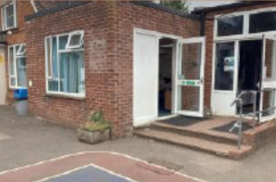
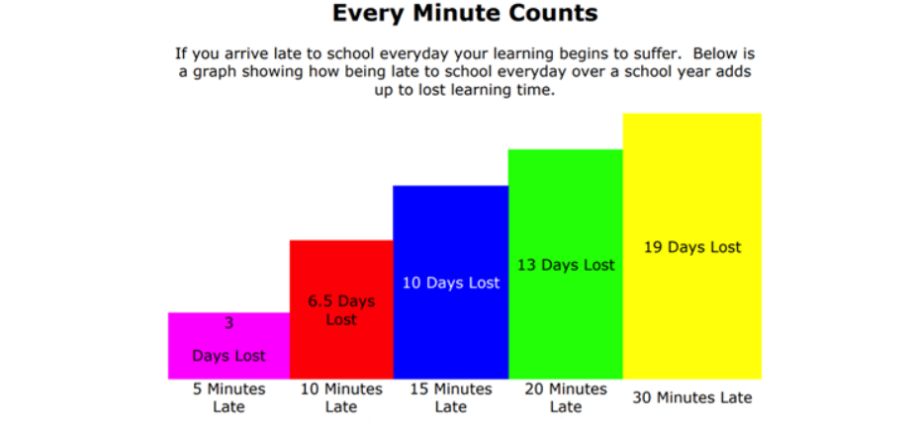
School Start and End Times
School starts at 8:40a.m.
Children in Y3 enter and leave by the
door onto the playground
Any child coming into school after 8.45a.m. must come in via the school office
School finishes at 3.25p.m. Monday – Thursday and at 2.10p.m. on Friday

Slide 4
Being Ready for School
Please ensure your child comes to school everyday in the correct uniform
Please ensure that they are dressed appropriately for the weather e.g. hats/raincoats
Label every piece of clothing!
Water bottles to be brought to school each day
Reading book brought to school each day - this helps for when we have reading volunteers

Slide 5
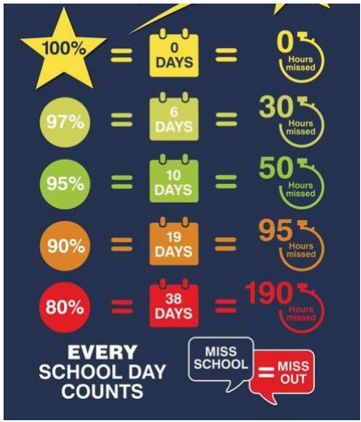
Attendance
Please ensure your child attends school at all times unless for illness or injury
Holidays during school time will not be authorised
Attendance is regularly monitored and you will be contacted by the school if your child’s attendance is low

Slide 6
Communication
Please come to speak to us at any time.
After school is always best because we are settling the children in in the morning.
Send an email if you can’t catch us at the end of the day: admin@digswell.herts.sch.uk
First speak to your class teacher
If not resolved, speak to the Phase Leader, Miss Brady
If issue is still not resolved contact the school office to arrange a meeting with the Assistant Head: Mrs de la Croix

Slide 7
Communication Reminders
All urgent messages should be communicated to the School Office via telephone or in person on the day.
Feel free to pass a note or letter to the member of staff outside on the playground in the morning.
All non-urgent messages that you wish to communicate via email should be directed to the school office on admin@digswell.herts.sch.uk – in the subject heading you can state who you wish the email to be forwarded to.
To make an appointment with the class teacher, please collect a form from the school office.

Slide 8


Slide 9
Reading
Accelerated Reading:
Children will be assessed every half term using the Star Reader test
All reading at home to be logged onto Boom Reader
This can be done via the Boom Reader app or the website
(boomreader.co.uk)
Once the children have finished a book they need to complete a quiz at school - asap

Slide 10
Reading at Home
Children will develop their reading skills through a variety of opportunities including independent reading, guided reading and shared reading.
Children will be able to read from:
  A levelled book following our schools Accelerated Reading scheme
  A library book – a book of their choosing from the school library or class reading corner
How you can help at home:
  Children should be reading at home everyday
  Talk about the book and ask questions.
  Ask them how the book was, do they like books by that author?

Slide 11
Reading at Home – Boom reader
  Children / adults to record daily reading at home
  App is available – can be done on phones / ipads or computer

Slide 12


Slide 13
Home Learning
Reading
Times Tables Rockstars – 2, 5, 10 times tables (Y2)
3, 4, 8 times tables (Y3)
Bingo Activity
(this can be found on the class page on the school website)

Slide 14


Slide 15
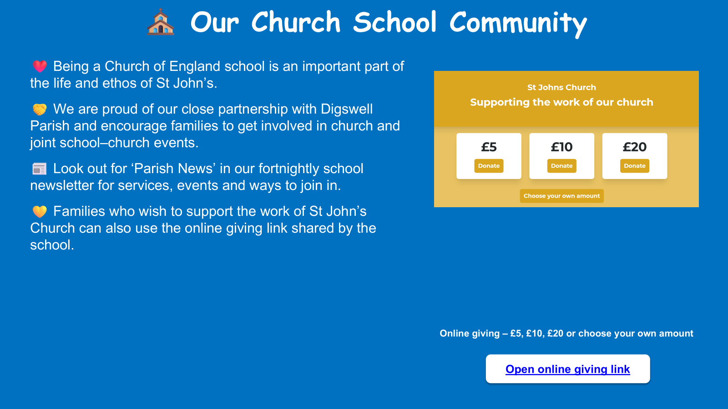

Slide 16
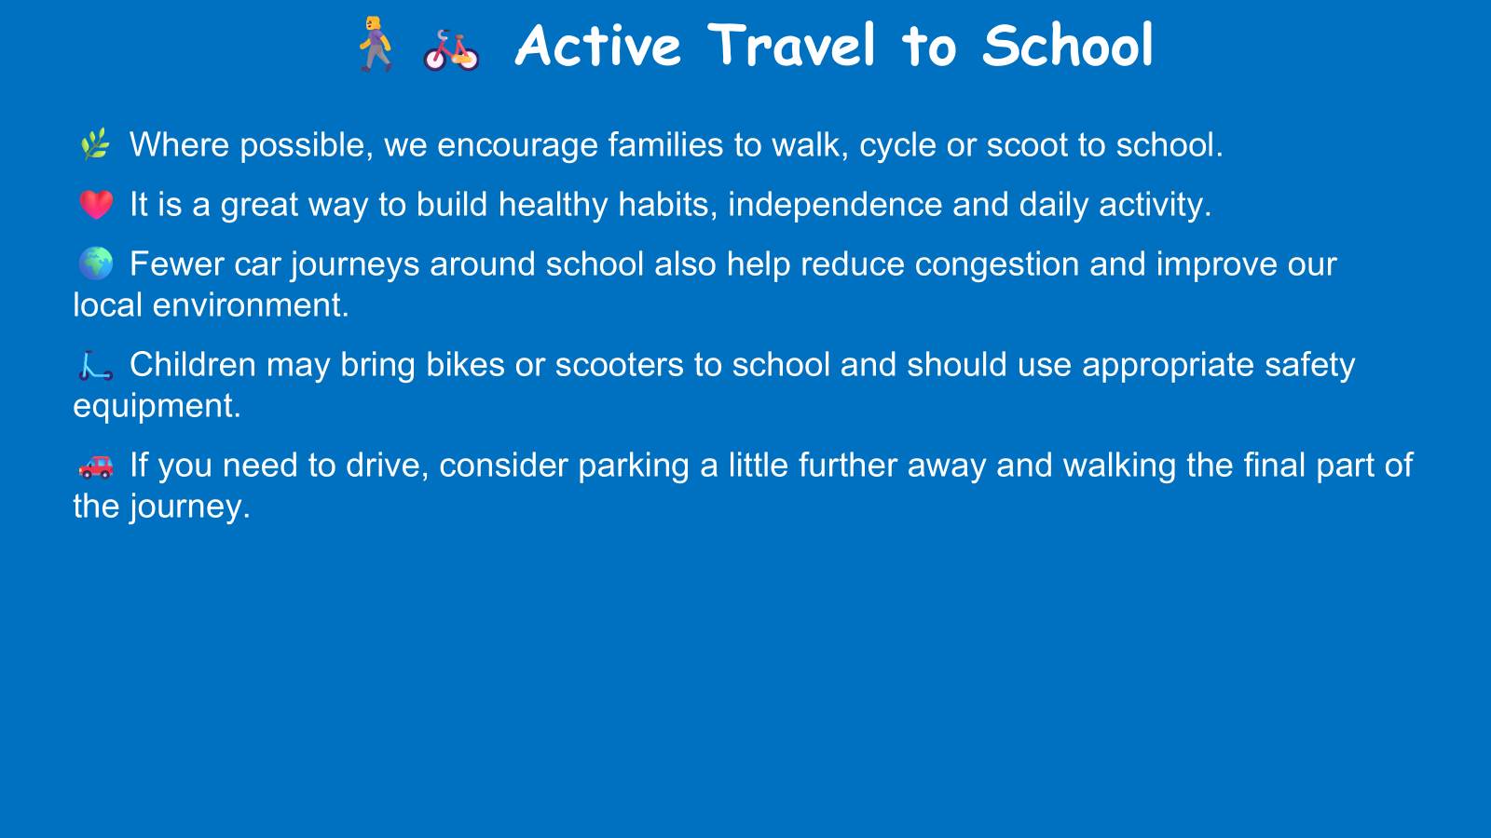

Slide 17
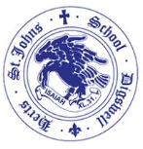
🤝We Love Parent Volunteers!
📖 Volunteers to hear readers are always welcome.
🛡️ A DBS check will be required if you are able to help on a regular basis.
❤️ Any time you can give is hugely appreciated and makes a real difference to our children.
🌍 Do you have a skill, language, hobby, profession or faith that you'd be willing to share? We'd love to hear from you!
🔗 Do you have any community or business contacts? If so, we'd love to be put in touch to help enrich our curriculum and experiences for the children.

Slide 18
Key Dates
Friday 11th September: Eucharist service at church (children to arrive at church at 8.40am)
Thursday 8th October: Harvest service at church (children to arrive at church at 8.40am)
Wednesday 21st / Thursday 22nd October - Parent consultations (info about booking will be sent out by the office closer to the time)
26th October - Half term
Thursday 17th November: Individual pupil photographs
Friday 13th November: Children in Need non-uniform day
30th November: Occasional day (school not open)
8th December: Whole school Christmas Panto
18th December: Carol service at church (children to arrive at church at 8.40am)

Slide 19
Thank You
Any questions?
Any further queries please email me on:
admin@digswell.herts.sch.uk

