Slide 1
Welcome to
St John’s Church of England Primary and Nursery School
Parents Meeting: June 2024

Slide 2
Today’s Meeting
To help your child make the best possible start to school.
To help you to understand the curriculum that your child will be covering in the reception class.
To understand how we teach to cover the requirements of the curriculum.
To identify the ways in which you can help your child at home and in school.
Housekeeping information

Slide 3
What is the Early Years Foundation Stage?
The Early Years Foundation Stage (EYFS) is the stage of education for children from birth to the end of the Reception year.
It is based on the recognition that children learn best through play and active learning.

Slide 4
EYFS Staff
Mrs Athill - EYFS/Lower Key Stage Leader - Reception Teacher
Mrs Wilkins - Reception – Early Years Practitioner
Mrs Blunden - Nursery Teacher
Mrs Robinson - Nursery - Early Years Practitioner
We have 30 children coming into reception

Slide 5
Three prime areas of learning and development
Communication and Language
Physical Development
Personal, Social and Emotional Development
Four specific areas of learning and development
Literacy
Mathematics
Understanding the World
Expressive Arts and Design

Slide 6
The three characteristics of effective learning- how young children learn- we focus on these when we plan and guide the children’s activities.
Playing and exploring
Active learning
3 Creating and thinking critically

Slide 7
Transition
Week 1
INSET MONDAY 2nd TUESDAY 3rd No children in school
Wednesday 4th - Group A 8.40am -10.40am
Group B 12.30pm - 2.30pm
Thursday 5th - Group B 8.40am -10.40am
Group A 12.30pm - 2.30pm
Friday 6th - Group A 8.40am - 12.00pm including lunch
Week 2
Monday 9th Group B 8.40am - 12.00pm including lunch
Tuesday 10th 8.40am - 12.00pm ALL IN including lunch
Wednesday 11th IN ALL DAY
https://stjohnsdigswell.net/prospectus/
https://stjohnsdigswell.net/early-years/

Slide 8
Groups for transition week
Group A
Theo Jake Dani Margarita Alani Kian Sienna Isla
James Alexander Gracie Eloise William Anik Callum Lylah
Group B
Sheunopa Elliot Leonardo Roy Zachary Owen George
Zane Theodore R Charlotte Jabari Oscar Tobias Fraser

Slide 9
Beginning school
We will take time to get to know your children and their interests – we will play and talk to them and begin recording some ‘wow’ moments.
We will be using Tapestry to record their learning journey but please be aware we do not put everything onto Tapestry.
On Tapestry I may leave some information/requests, tag next steps, add an observation or wow moment.
Please feel free to comment on the observations.
Don’t forget to add your own Wow moments – it is an important to have a strong link with their home.
Show and tell

Slide 10
Year 6 Buddies
Every child will have a Year 6 buddy. They will help them settle in and take them to lunch during their first full week.
For one week they will play with them in the EYFS playground during lunchtime.
Before the Summer, your buddy will write them a letter to introduce themselves.
Throughout the year, your buddy will join them for playtimes and reading.
When we go to church, your buddy will walk with us.
** Buddy letter and bag for the summer.

Slide 11
A typical day in Reception…
8.40am Children line up/enter the classroom (parents to stay at the door) Busy fingers activities.
8.55am Register
9.00am Phonics
9.45am Run the mile and play on the equipment
10.00am Own learning and adult focused tasks with rolling snack (fruit and milk)
11.00am Learning and Adult Led Activity
11.30am Get ready for lunch/story/prayer
11.45am Lunch
12.45pm Register and Adult Led Activity
13.30pm Own learning and adult focused tasks
14.30pm Show and tell/snack/singing
15.00pm Getting ready for home/Story time
15.25pm Home time
Reception learning is not always clean! Please be understanding!

Slide 12
Reading meeting and Monster Phonics In October I will hold a meeting to explain how we teach phonics and reading. Please don’t worry if you do not have a reading book straight away, I will be assessing them throughout the first few weeks and I will decide when they are ready for a reading book. Formal phonics teaching will begin within the first few weeks of school.

Slide 13
Permission slips and ordering milk
Tapestry – please sign with your email, child's name and their date of birth. You will be sent a activation link when your name is added to the account.
Photograph permissions on Arbor – Website, newsletter, display boards and Tapestry.
These are for the new Reception Class picture in the local newspaper, pictures around the school and on the newsletter. Very occasionally we might add photos to our new class page on the website.
Milk ordering needs to be ordered before the next term – see form
If your child is 5 before Christmas, you will need to pay for milk.

Slide 14
Medical Matters
All of the EYFS team have paediatric first aid certificates.
All have EpiPen training and SEND training, which is updated yearly.
Please make sure we know of any medical issues that will impact your child’s learning.
A signed red form will be needed if an inhaler or medicine if they are to be administered.
Any sickness, diarrhoea, must be followed by 48 hours absence.
Any absences requires a telephone call explaining the reason.
Head lice are fairly common! Please check regularly and treat as recommended.

Slide 15
The daily mile and healthy eating
Every day we run the perimeter of the playground. Exercise has proven to aid concentration and help children to learn.
We hold a healthy eating school status. Please be aware that if you are sending in a home packed lunch then we encourage healthy food options and no nuts.
Remember to book your meals in the first week in school. (School Grid)
Water and milk are given daily so there is no need for a child to have juice.
Milk is free unless your child is turning 5 during the first term.
Named water bottles are essential.

Slide 16
Attendance
Although the statutory school age is 5, getting into good routines is essential to ensure that learning opportunities are not missed.
Absence in Reception class can be unauthorised, but fines cannot be issued.
Please ensure your child is in school on time. School starts at 8:40am
It is important your child is in school every day.
If your child has any appointments please try and have it outside of school hours, but if it is unavoidable then please contact the school office to let the school know.

Slide 17
Uniform
Uniform can be ordered through our website.
White t-shirt, grey trousers/shorts/skirt and blue school jumper/cardigan.
Blue gingham dresses for the summer
Sensible black shoes not boots
PE kit to be worn for 1 day a week
Black shorts/tracksuit bottoms, white t-shirt trainers.

Slide 18
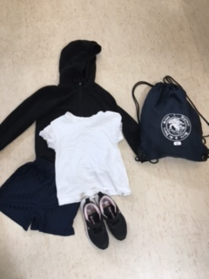
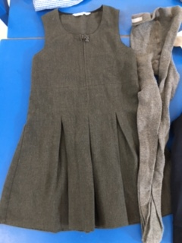
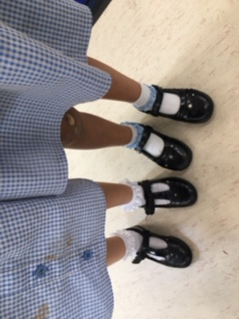
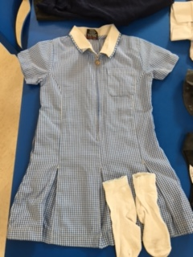
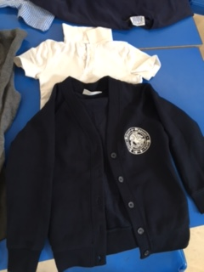
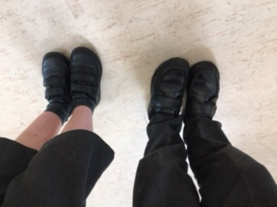
Uniform
Examples

Slide 19
Other matters
Parent Teacher Association (Friends of St John's)
friends@digswell.herts.sch.uk
School Lunches- provided by Herts Catering
Free School Meals and Pupil premium
School Nurse – visit
Forms to be signed

Slide 20
Friends of St John’s
Pricelist
Branded sweatshirts/cardigans £3
Non-branded sweatshirts £2
Trousers/Shorts/Skirts £2
Pinafore dress £3
Summer Dresses £2
Polo shirts 50p
Coats £3
Hats £1
Branded Book Bag £2

Slide 22
What does my child need at school?
Named coat
Named wellies - please leave these in school during the term
Named book bag - please bring everyday so letters, library and reading books can be transported safely
Named water bottle- We can refill them at school
Name all uniform/equipment

Slide 23
What do teachers mean by being school ready?
Across four years of school readiness research, teachers have been clear and consistent in what they think being developmentally ready for Reception means.
Independence: dressing, eating and toileting - Schools expect children to be sufficiently independent, able to use the toilet, dress and feed themselves and to be able to cope with being away from their parents.
Playing, sharing and turn-taking: Children are expected to have some social skills, such as playing, taking turns and sharing, which are important for developing friendships and engaging in learning activities.
Basic verbal skills: Communicating in short and clear sentences and verbalising needs and have some familiarity with nursery rhymes.
Following simple instructions: Children are able to sit and listen, follow and act on simple instructions and can focus and concentrate for short periods of time.

Slide 24
What can I do to help my child ?
Put on their coats independently
Go to the toilet independently
Be able to feed themselves
Count to 10 and collect 10 objects independently
Know their colours
Independently get dressed in the morning
Write their name
Be able to communicate their needs
Turn taking when playing games and sharing toys
Listen to stories and poems together

Slide 25
And Finally…
If you have any worries or concerns, then please speak to myself or Mrs Wilkins, email admin or write it on a piece of paper, along with your email and pop it in the box. ☺
Thank you for coming

